Slide 1
Climate Change 2022: Impacts, Adaptation and Vulnerability
Working Group II contribution to the IPCC’s Sixth Assessment Report)
Professor Lesley Hughes

Slide 2
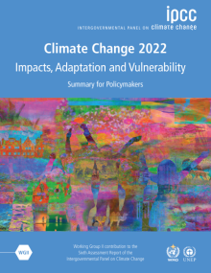
Background
Second instalment of the IPCC’s Sixth Assessment Report
Most comprehensive and authoritative update on the state of climate change knowledge ever undertaken
WGI on the physical science released last August
WGII contribution outlines impacts of climate change already being experienced and will be experienced in future, vulnerability of specific populations, ways we can adapt to escalating impacts, limits to what we can adapt to
The most authoritative synthesis of the science on the impacts of climate change on Australia to date

Slide 3
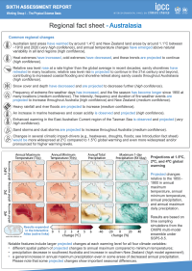
Background (cont.)
The report consists of:
The Summary for Policymakers
  40-page document negotiated by governments containing the most important conclusions
Detailed chapters on specific topics and regions
Regional factsheets

Slide 4
AR6 Working Group II in numbers...
270 authors from 67 countries
Over 34,000 cited references
Over 62,000 expert and government review comments
WG III report out in early April

Slide 5
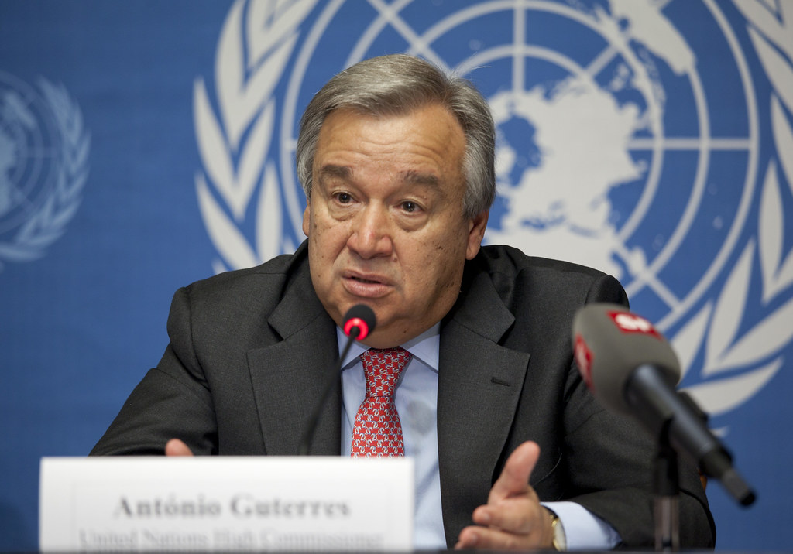
CODE RED FOR HUMANITY

Slide 6
AN ATLAS OF HUMAN SUFFERING

Slide 7
“I have seen many reports in my time but nothing like this. Nearly half of humanity is living in the danger zone now. Humanity is getting clobbered by climate change. ...Fossil fuels are choking humanity. Those still financing coal should be held to account. Now is the time to accelerate the transition to renewable economy.”
- UN Secretary General Antonio Guterres

Slide 8
It’s worse than before
Current and future impacts are significantly greater than those presented in the Fifth Assessment Report in 2014
Climate change is:
altering ecosystems all over the world; and
affecting our physical and mental health, water security and food production, cities and infrastructure, and more

Slide 9
There are hard limits to what we can adapt to
Risks escalate with every fraction of a degree of further warming
Ability to adapt fundamentally depends on emissions reductions
Irreversible impacts are occurring in some natural and human systems

Slide 10
Climate change is affecting our health and security
Mental health challenges, nutrition, vector-borne diseases, heat stress, and respiratory distress through increased exposure to bushfire smoke
Increased drought, heat, flooding and fire, result in cascading impacts upon food and water resources, health, and supply chains

Slide 11
Climate change is exacerbating inequality
Indigenous vs non-indigenous
Urban vs rural
Between generations

Slide 12
There is still so much we can and must fight for
Our future depends on far stronger action this decade.
Near-term actions limiting warming to close to 1.5°C would substantially reduce projected losses and damages
  But cannot eliminate them all

Slide 13
Some key points from the Australasia chapter
Climate change is here and now
More hot days, heatwaves, less snow, more rain in the North, less rain during cool seasons in SW and SE, more extreme fire weather in SE

Slide 14
Some stats:
1987-2016: natural disasters caused an estimated 971 deaths and 4,370 injuries, 120 people made homeless, 9 million affected
>50% of these deaths & injuries came from heatwaves in cities and 22% from fires
2007-2016, natural disasters costs averaged A$18.2 billion p.a. with largest contributions from floods (A$8.8 billion), followed by cyclones (A$3.1 billion), hail (A$2.9 billion). Storms (A$2.3 billion) and fires (A$1.1 billion)
Bushfires in 2019-20 cost over A$8 billion

Slide 15
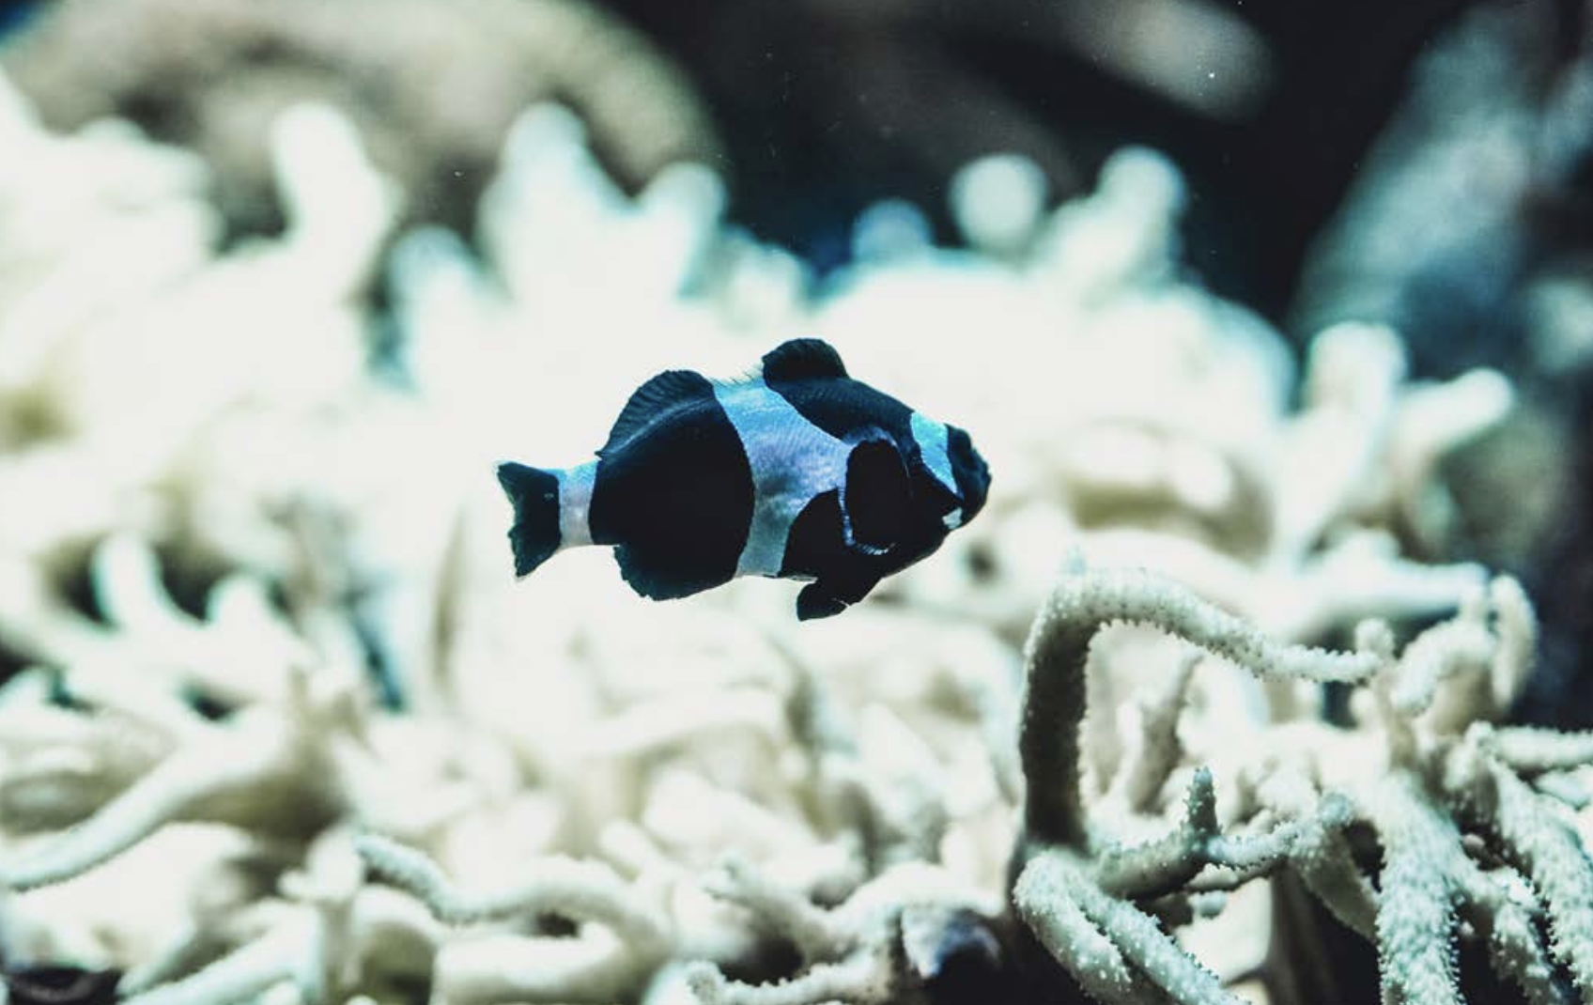
Many ecosystems at the precipice

Slide 16
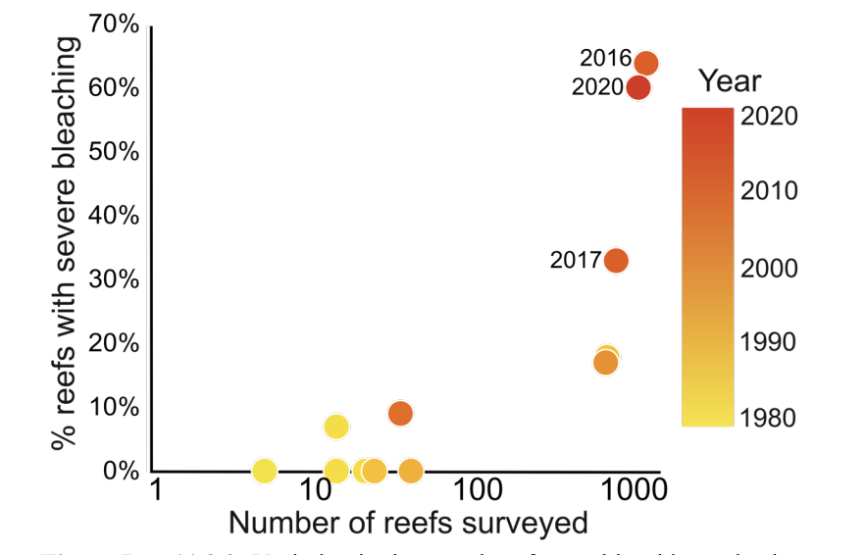
Variation in the severity of mass-bleaching episodes recorded on Australia’s Great Barrier Reef over the last four decades (1980–2020).

Slide 17
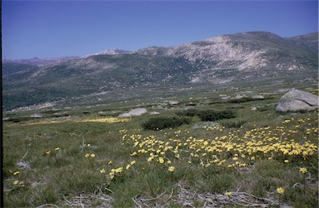
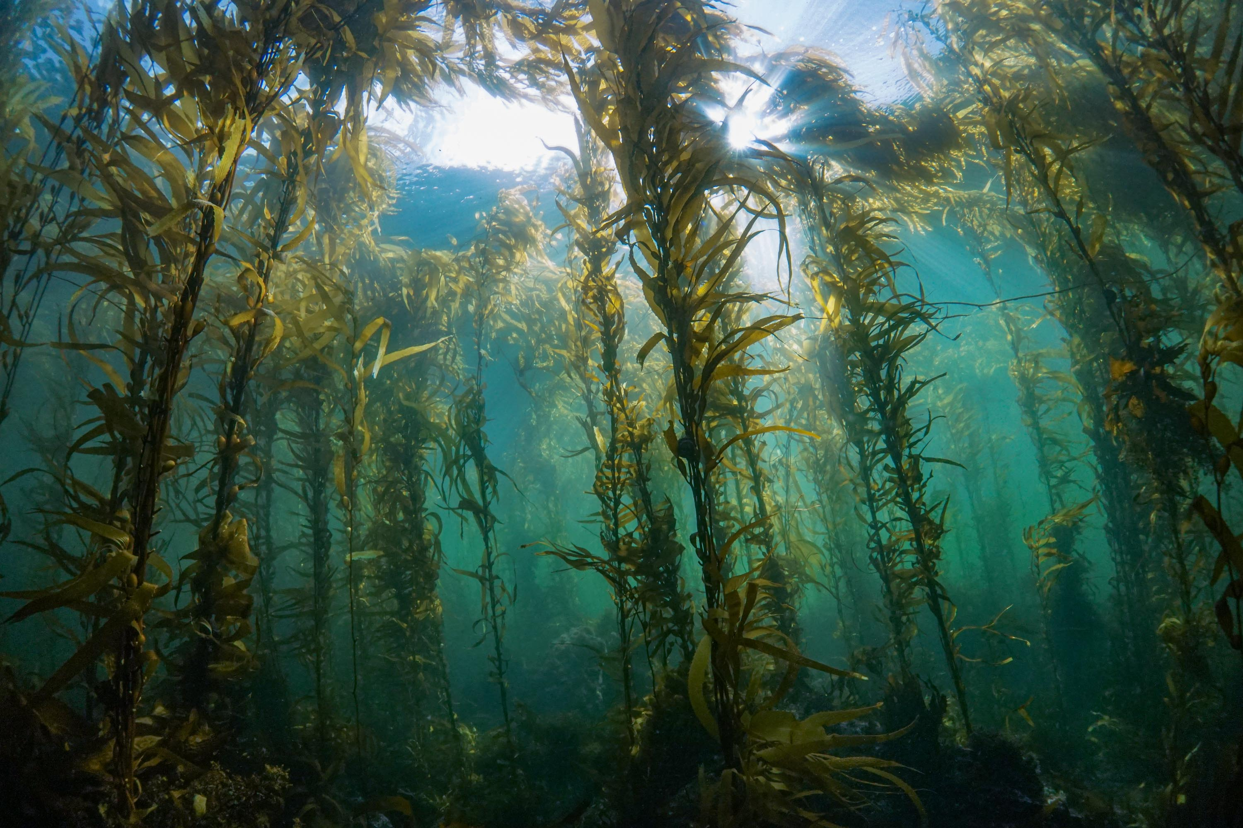
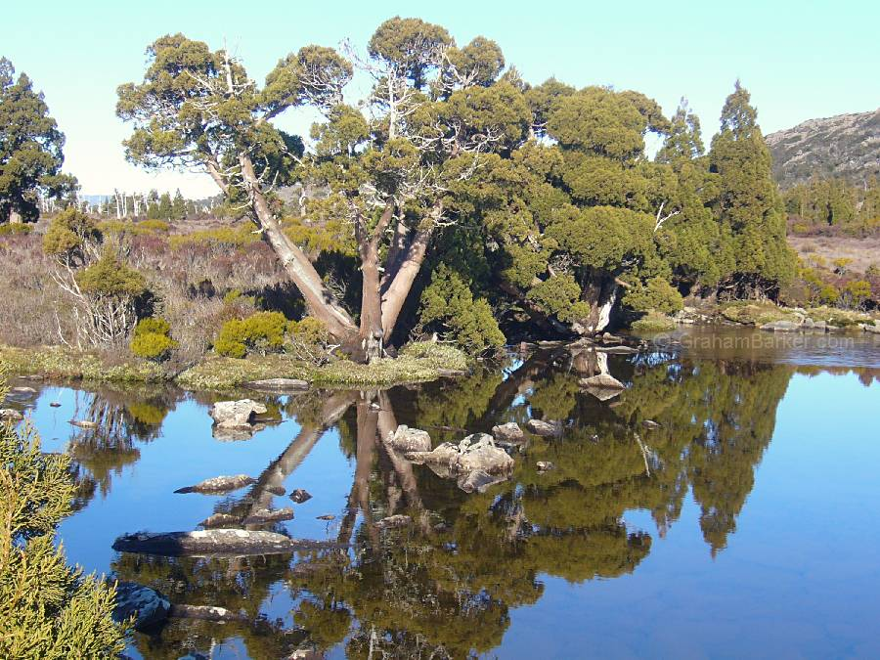
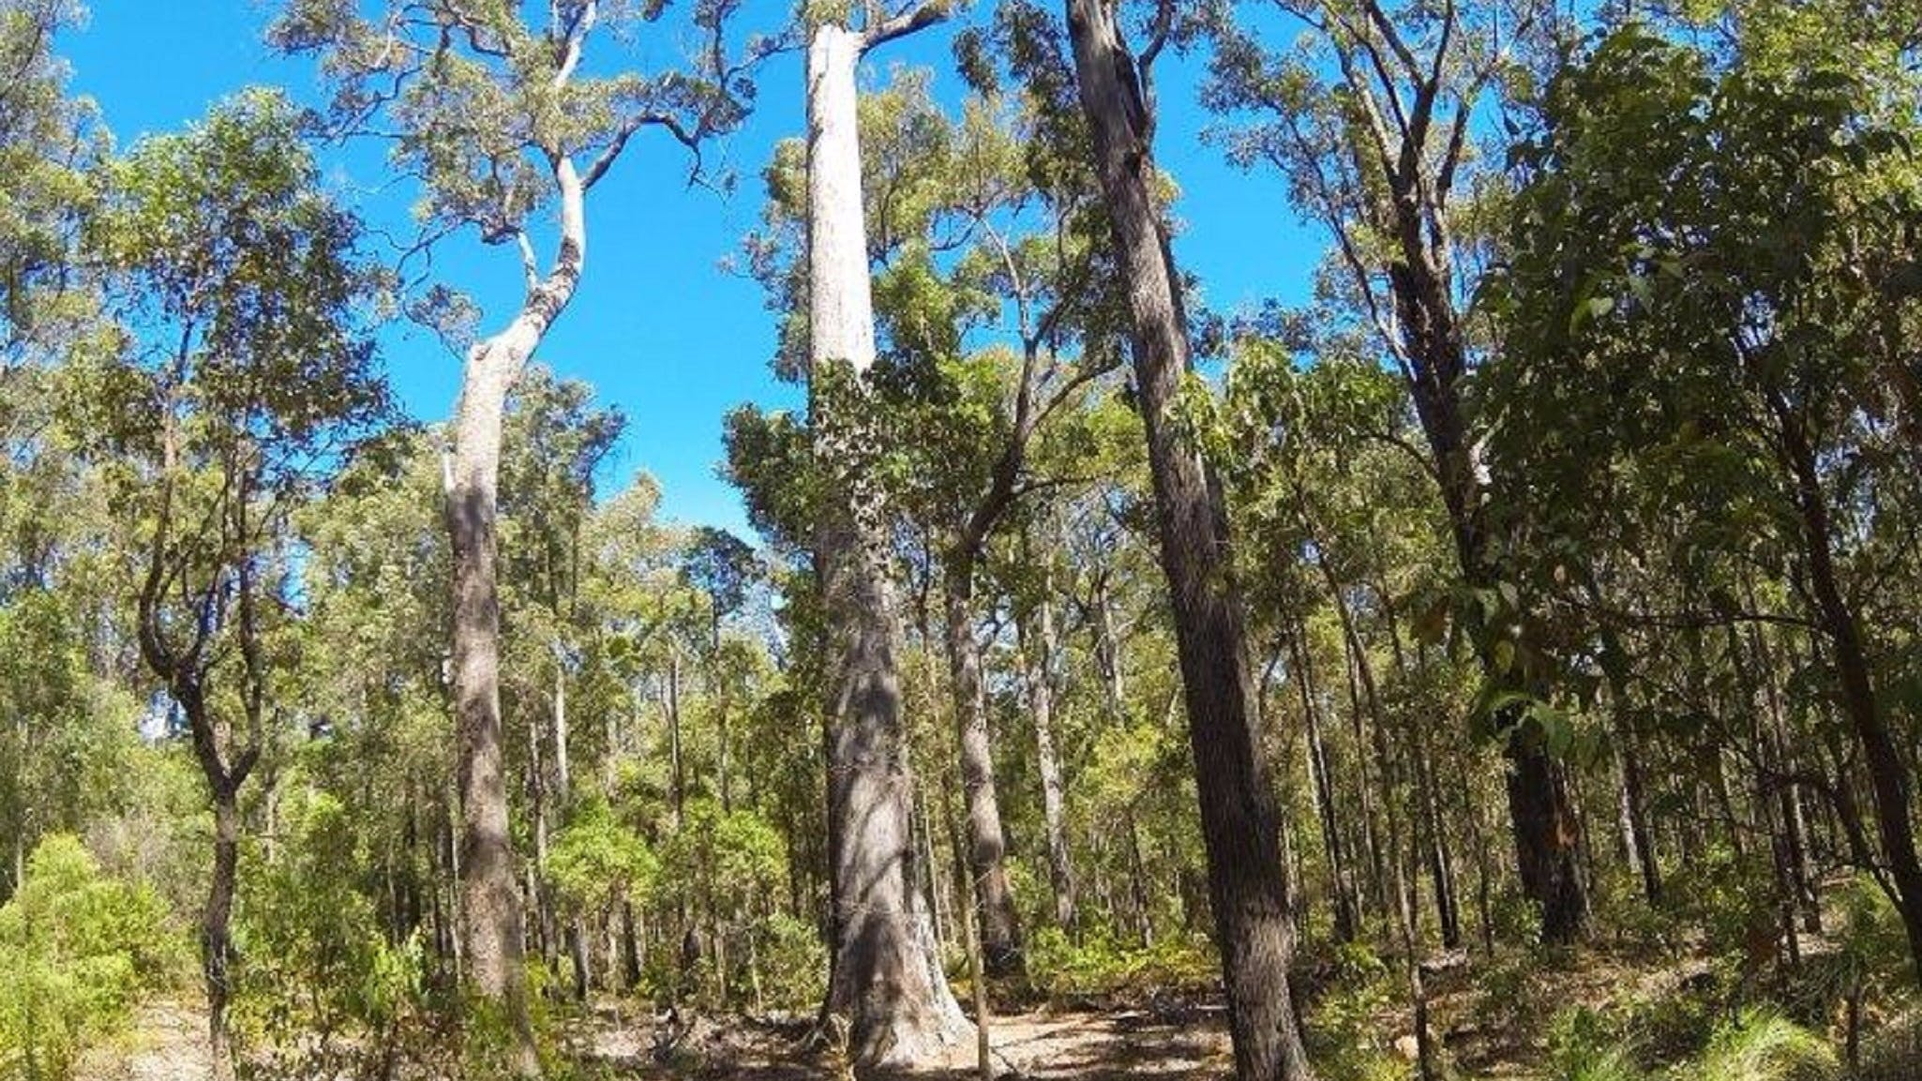
At ‘critical thresholds’

Slide 18
Heat is deadly
Heat-related deaths in Sydney, Melbourne and Brisbane increased by more than a third in recent decades
Urban heat-related deaths could increase to 300 people per year (2030-2080, low emissions scenario) & 600 pa (high emissions scenario)
Climate change is harming our mental health
Loss of sense of identity and place, heightened anxiety, risk of depression, post-traumatic stress disorder and suicide

Slide 19
Climate change is hurting agriculture
Australia projected to experience a decline in crop and horticulture production, mainly due to heat and declining cool season rainfall in SW, SE & S
Climate change is reducing snow cover
Annual maximum snow depth is estimated to decrease from current levels by 15% by 2030 and 60% by 2070

Slide 20
Climate change is increasing fire risks
Hotter and drier conditions have increased extreme fire weather risk since 1950
Fire season of 2019–20 was at least 30% more likely than a century ago due to the influence of climate change

Slide 21
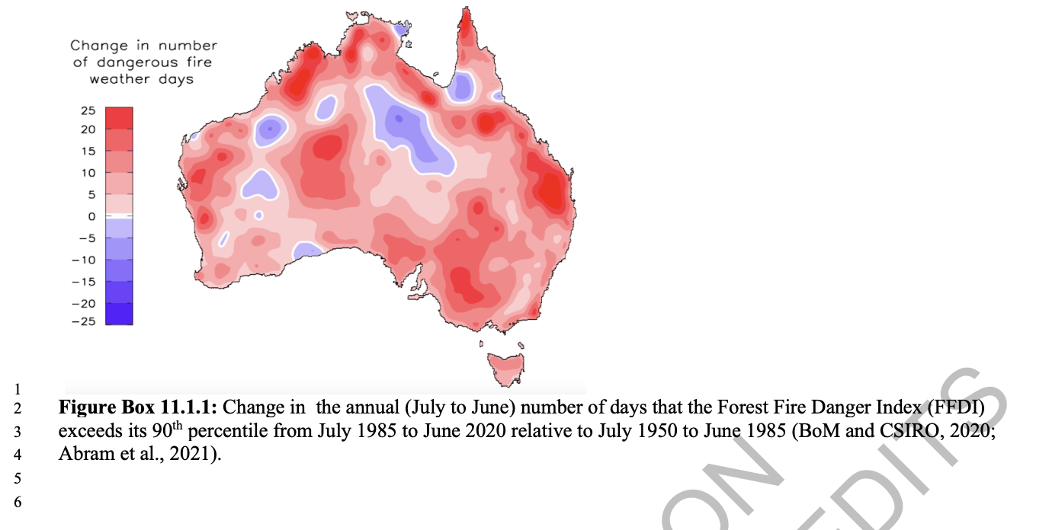

Slide 22
Economic costs
Aggregate loss of wealth due to climate-induced reduction in productivity across agriculture, manufacturing & service sectors projected to exceed A$19 billion by 2030, A$211 billion by 2050 and A$4 trillion by 2100 (high emissions scenario)
Finance sector has significant exposure to climate variability & extreme events
Aggregated insured losses from weather-related hazards from 2013-2020 were almost A$15 billion (1.2% GDP)

Slide 23
Climate change is having serious impacts upon First Nations, including communities in the Torres Strait Islands
Torres Strait Island communities are already experiencing
increased flood risk and water insecurity
Sea level rise has undermined traditional coastal lands,
including through the destruction of ancestral burial grounds
Impacts are predicted to intensify

Slide 24
Challenges for adaptation
Complex connections are generating new types of risks, exacerbating existing stresses, and constraining adaptation options
Ambition, scope & progress in adaptation has increased across governments (mostly state & local), NGOs, businesses & communities
But adaptation progress uneven and there are remain gaps, barriers, limits & adaptive capacity deficits
Both incremental and transformational adaptation opportunities still available in most sectors

Slide 25
Challenges for adaptation (cont)
Greater shift from reactive to proactive adaptation is critical, step change needed to match rising risks and support ‘climate resilient development’
Adaptation progress being hampered by current urban redevelopment practice and statutory planning guidelines, specially with regards to removal of green space
Tensions between managed relocation & personal values and between adaptation & mitigation goals
But win-wins are possible

Slide 26
Climate change may overwhelm our governance systems
Climate impacts are accelerating, cascading and compounding
Scale and scope of projected impacts could overwhelm the capacity of key institutions and governance systems
Stronger action now will be measured in lives, livelihoods and species saved
E.g. the increase in heat-related deaths in cities could be halved if Australia and the world take action

Slide 27
Climate change and floods
All weather is occurring in a warmer, wetter and more energetic atmosphere caused by burning fossil fuels
7% more moisture in the atmosphere for every degree of warming
Drier areas are drier and wet areas are wetter
Example of communities are being hit by successive disasters compounding the impacts

Slide 28
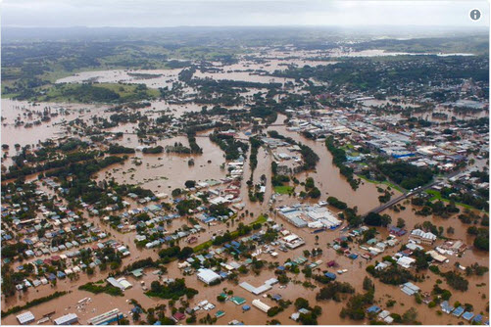
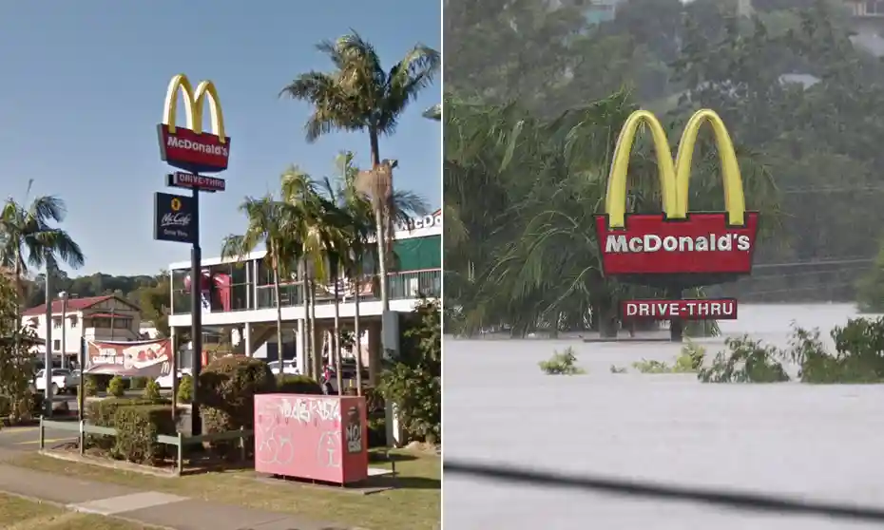
Lismore flooding in 2017 (left) and in 2022 (right)
Source: Twitter @rubycornish
Source: The Guardian

