Slide 1
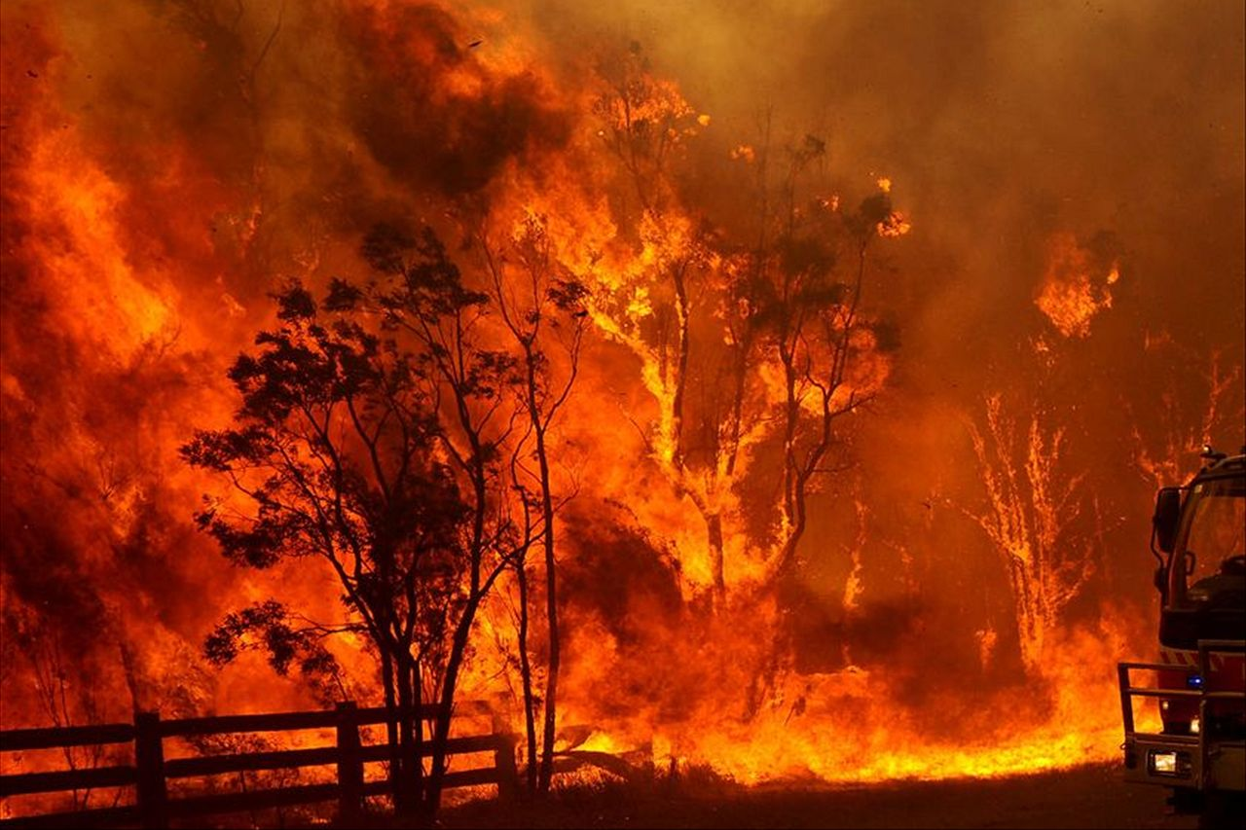

IPCC Report Briefing
Lesley Hughes

Slide 2
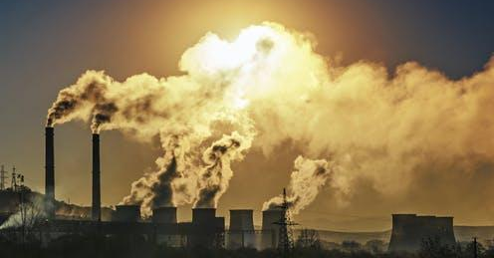
Outline
What is the IPCC & why is the AR6 so important?
Key messages
What we need to do

Slide 3

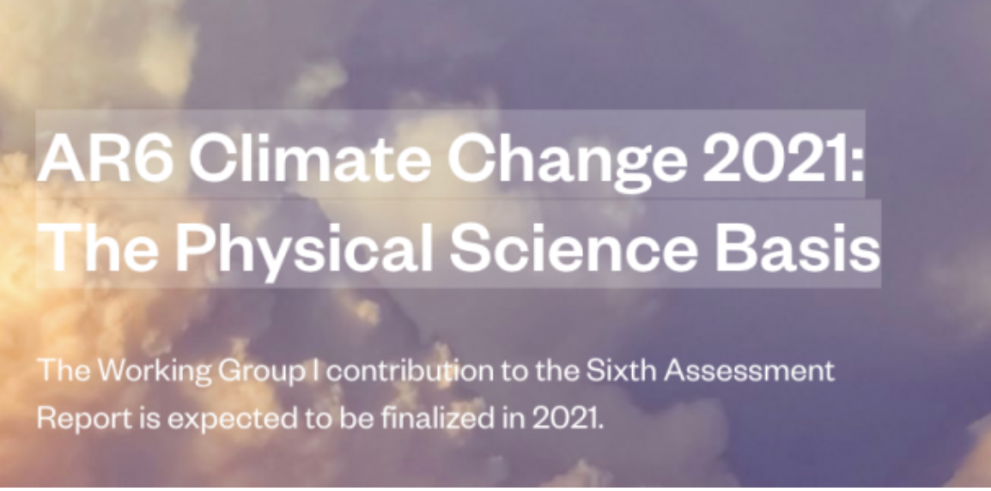
Released 9th August
Climate change widespread, rapid, and intensifying
Notes:
Leaked report indicates many tipping points are closer than previously thought

Slide 4
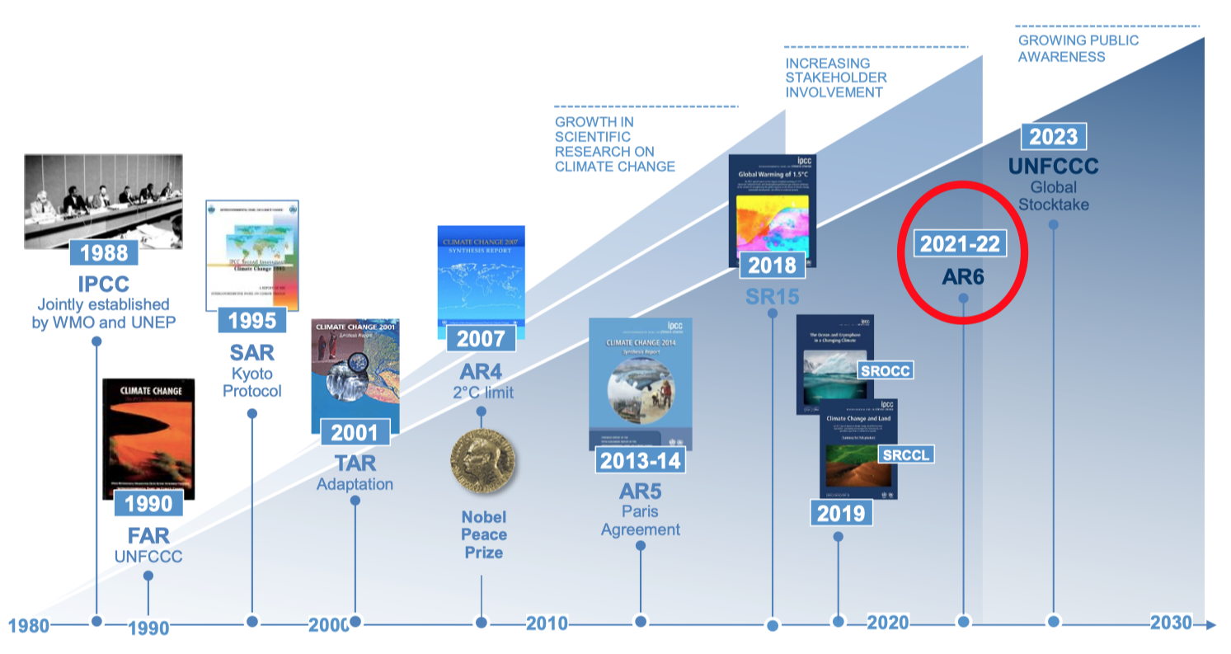

Slide 5
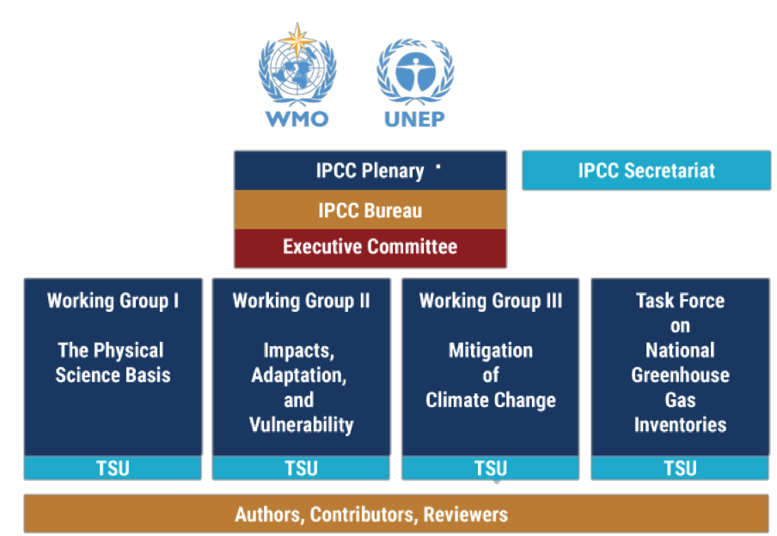
IPCC structure
(WGI)
(WGII)
(WGIII)

Slide 6
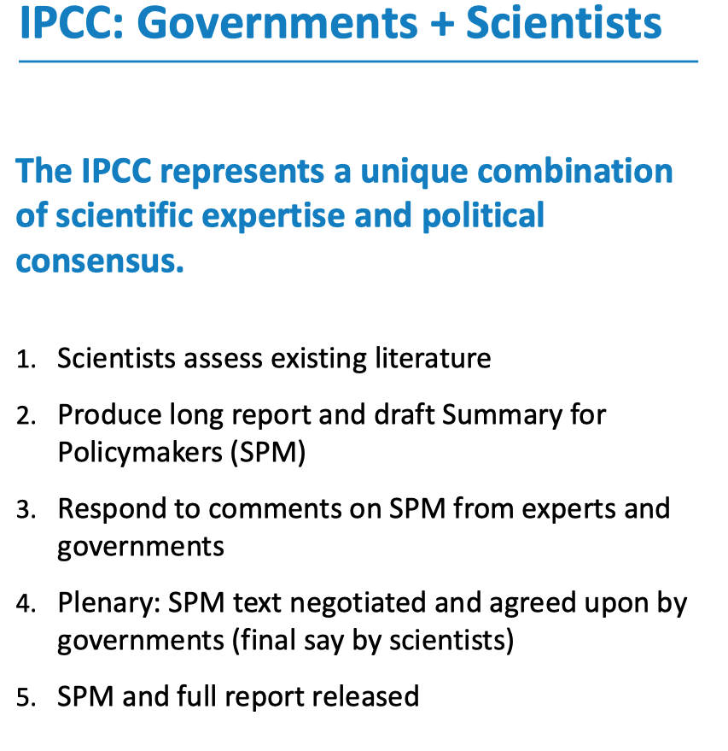

Slide 7
Report Statistics
Author team (Coordinating Lead Authors, Lead Authors, Review Editors) | 234
Review Comments | 78,007
Number of papers reviewed (citations) | 14,000
Number of pages (unformatted) No. words | 3,900 >1 million

Slide 8
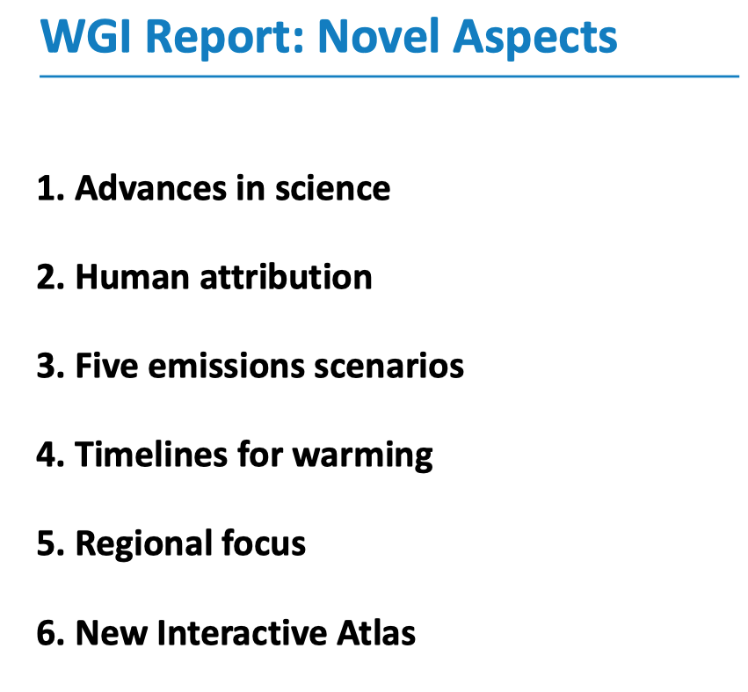

Slide 9
Key Findings
1. The scale and pace at which humans are changing the climate system has almost no precedent.

Slide 10
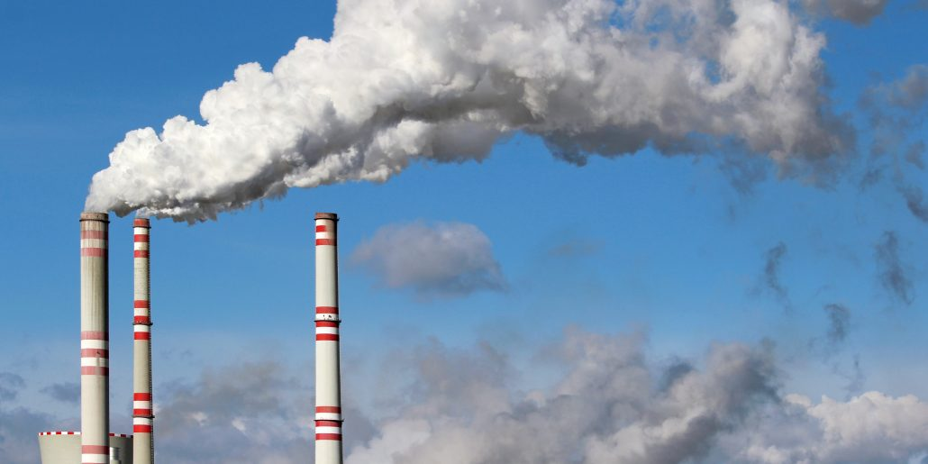
Atmospheric CO₂ now 417 ppm,
up 49% since pre-industrial
Highest level for at least 2 million years
Rate of increase over past 2 decades ~100 X max rate during last deglaciation

Slide 11

NASA report, June 2021
Amount of heat trapped near Earth’s surface ~doubled since 2005
Earth warming faster than expected
https://www.nasa.gov/feature/langley/joint-nasa-noaa-study-finds-earths-energy-imbalance-has-doubled
Notes:
Report released June 15th this year – main point is that projections of climate change thus far have likely been too conservative.

Slide 12
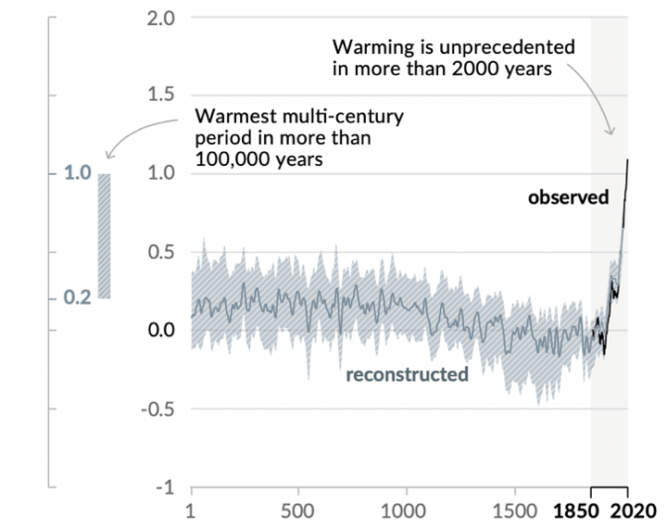
Changes in global surface temperature relative to 1850-1900
IPCC AR6

Slide 13
Rates of Change
Since 1970 global average temperature has risen at rate ~200 times the background rate over the past 7,000 years of the Holocene, and in the opposite direction.
Current rates of CO₂ & temperature change are almost
unprecedented in the entire 4.5 billion-year geological past.
De Vos et al. 2014; Wolff 2011; Marcott et al. 2013; NOAA 2016; Canfield et al. 2010; Lear et al. 2020

Slide 14
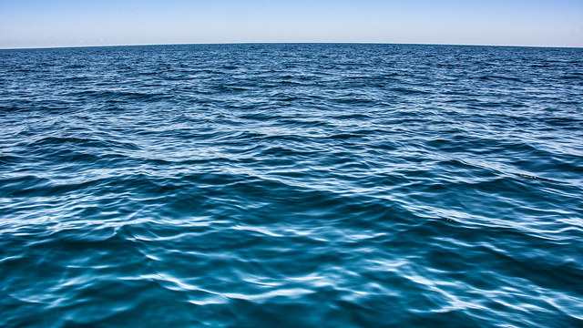
Oceans
Absorbing 93% excess heat, warming detectable to 2km
Oceans 30% more acid than pre-industrial times

Slide 15
Key Findings
2. Climate change and its impacts are accelerating

Slide 16
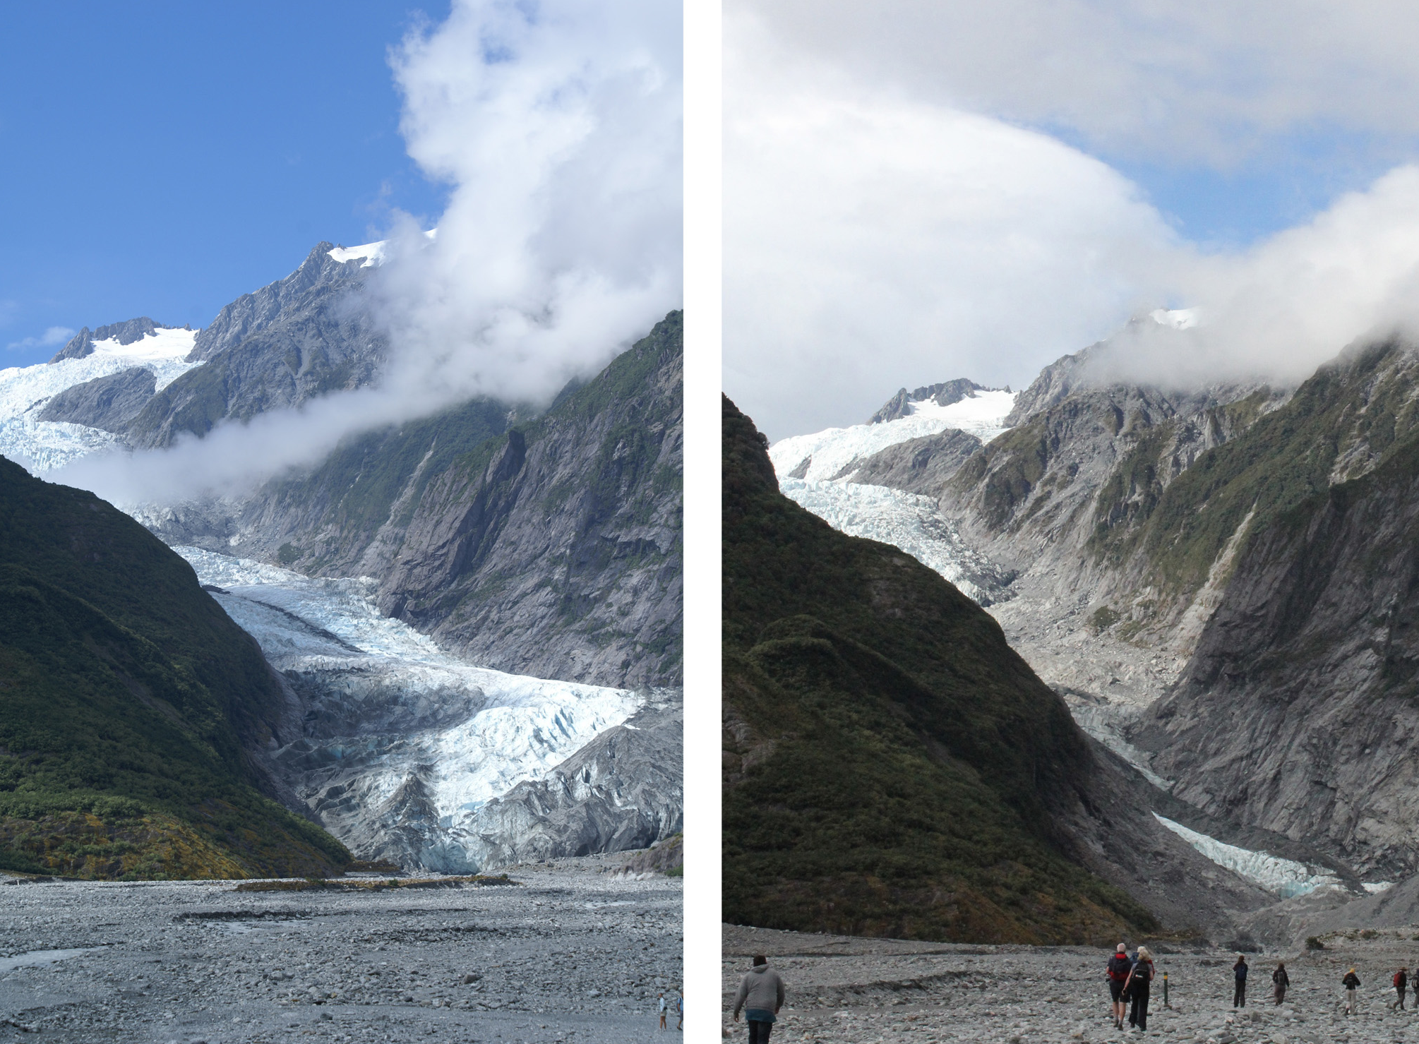
Glaciers
retreating & will continue to do so for decades
2009
2013
Notes:
Muir glacier, Alaska
Around one sixth of the world’s population relies on glacier melt for freshwater supply

Slide 17
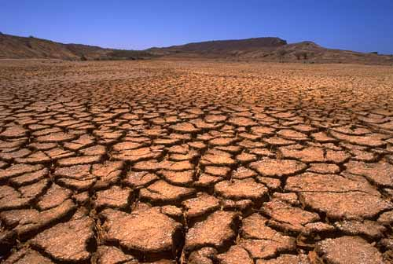
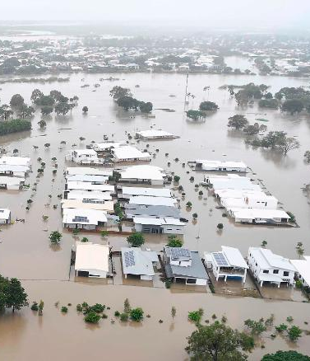
Water cycle intensifying

Slide 18
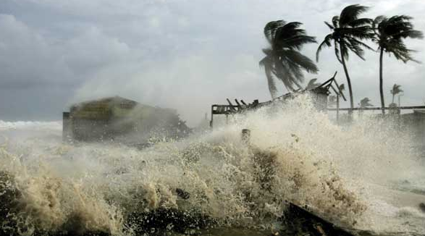
Cyclone intensity increasing

Slide 19
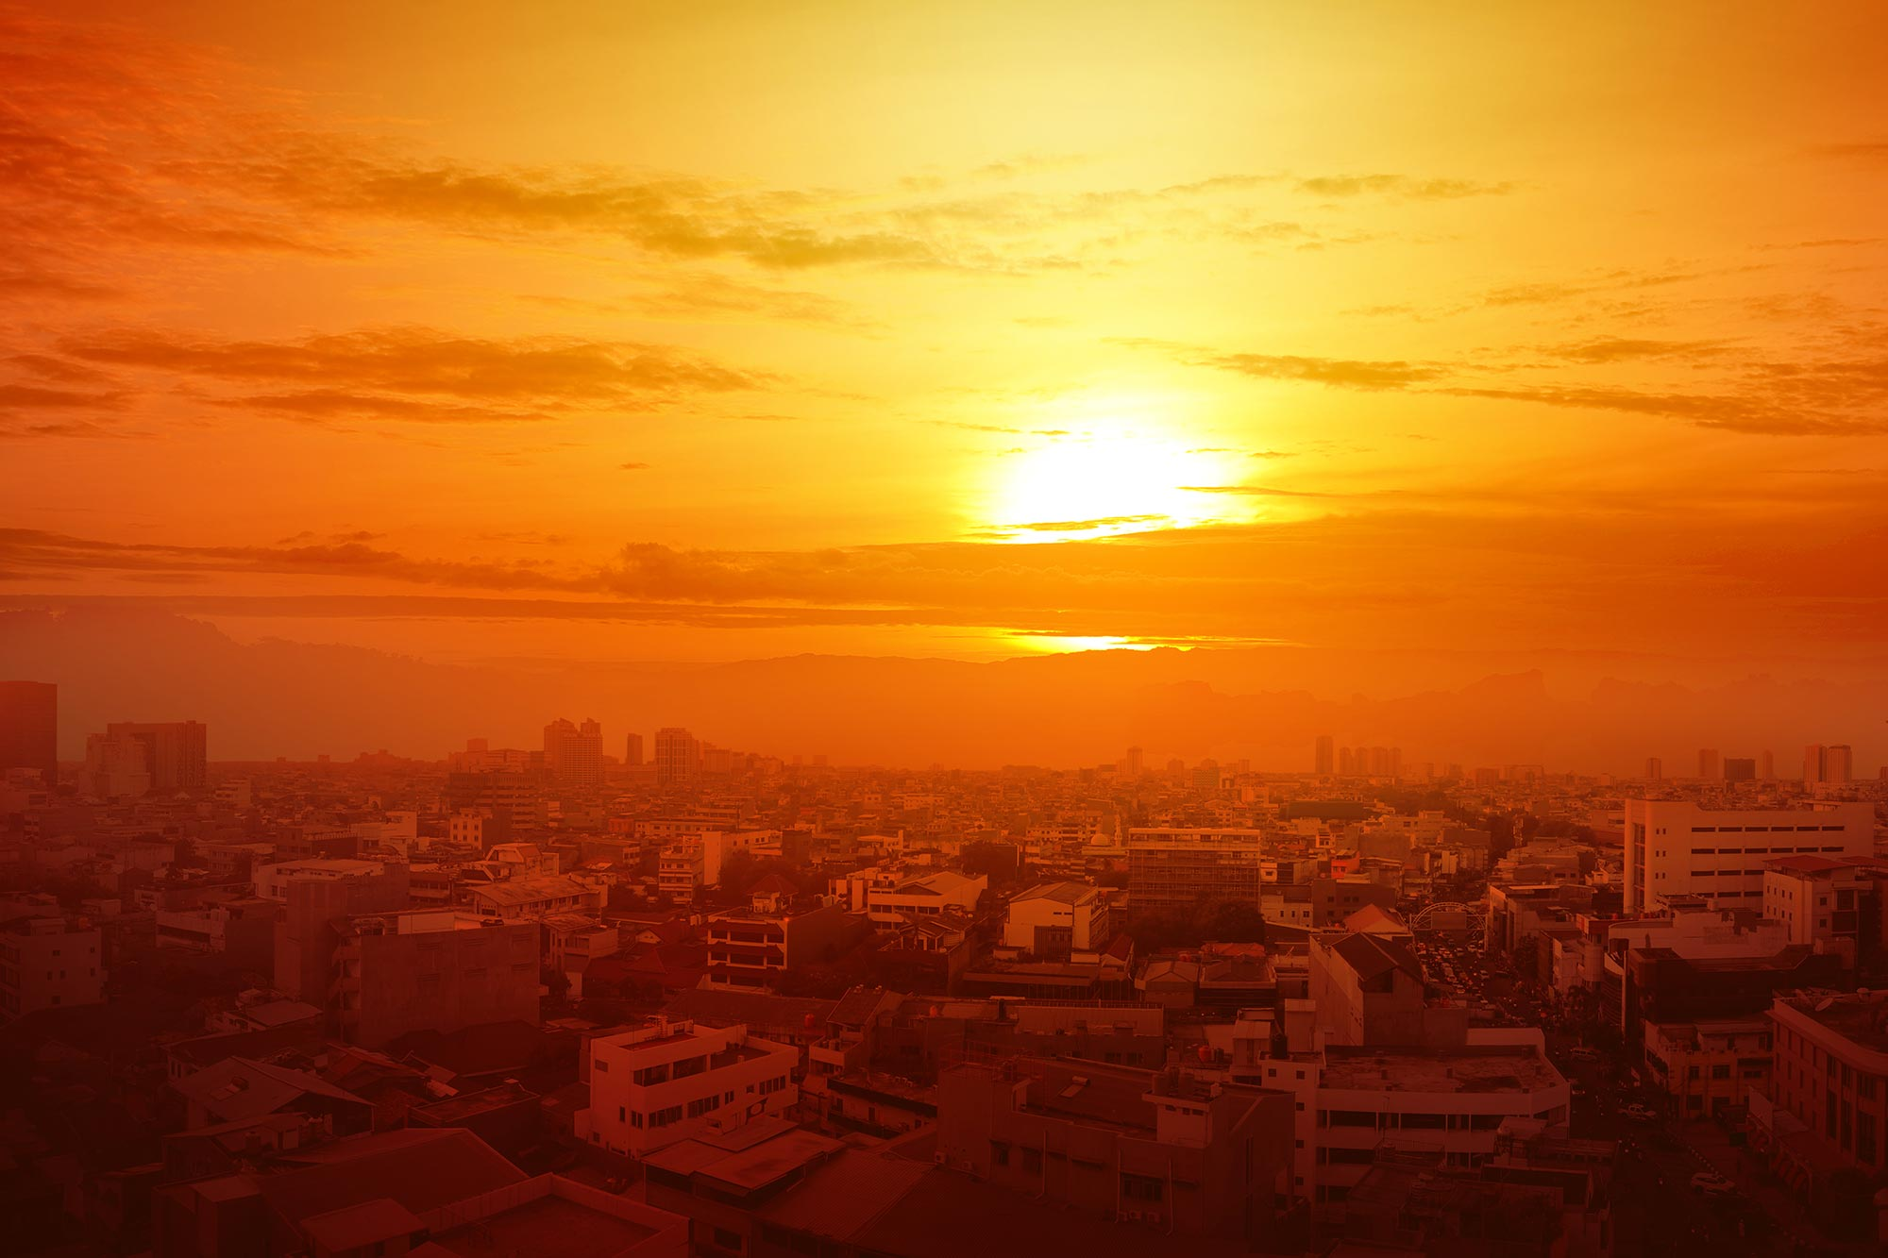
Extreme heat & heatwaves increasing
2020 hottest year on record
Last 7 years were the hottest 7 on record

Slide 20
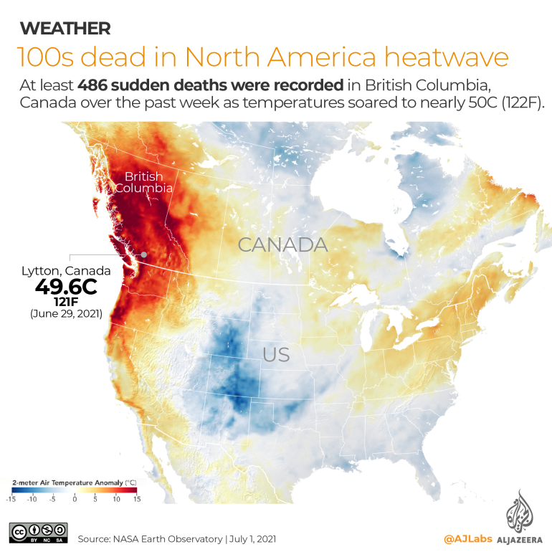
Canada, July 2021
‘heat dome’, temperatures nearly 50ºC
Extensive wildfires
~ 500 deaths
Event at least 150X more likely because of climate change
An event like this – currently estimated to occur only once every 1000 years, would occur ~ every 5 to 10 years with 2°C of warming
https://www.worldweatherattribution.org/western-north-american-extreme-heat-virtually-impossible-without-human-caused-climate-change/

Slide 21
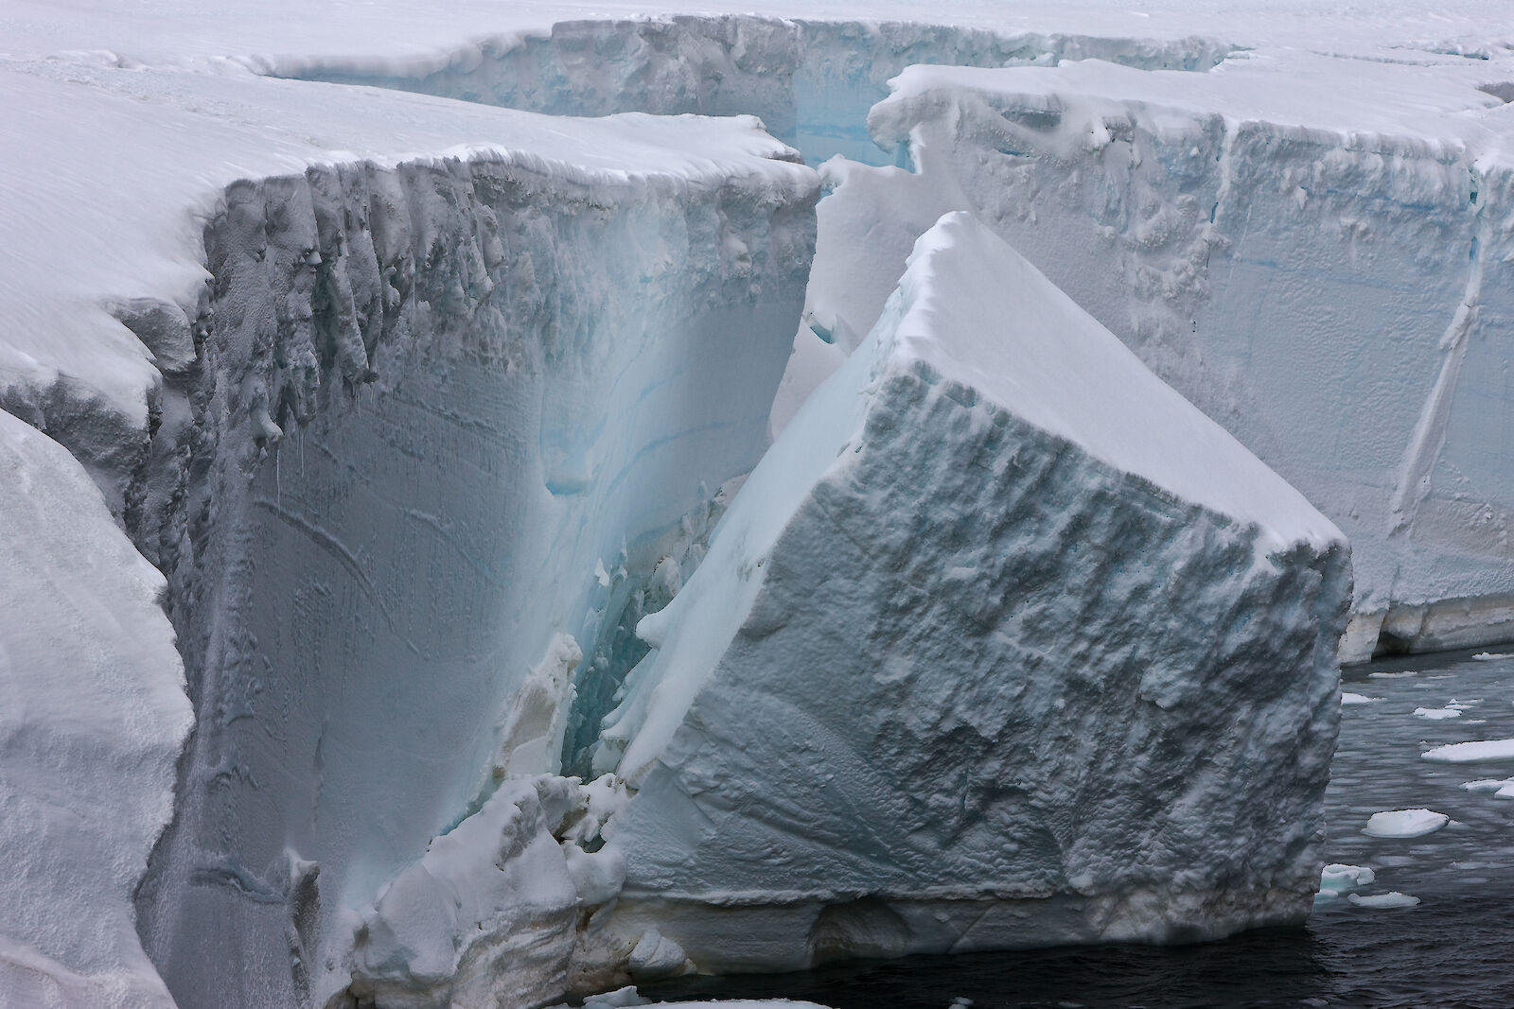
Rate of ice sheet loss increased 4x
1992-1999 cf 2010-2019

Slide 22
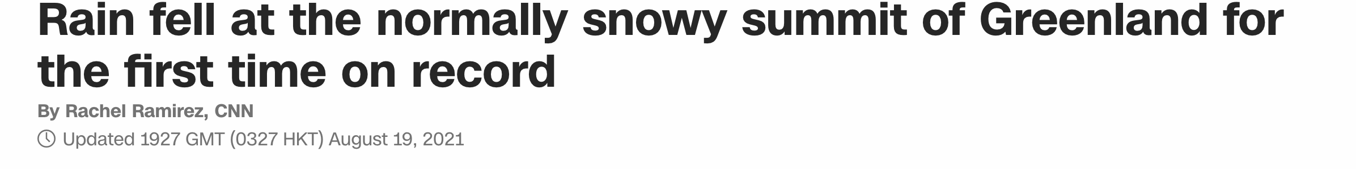
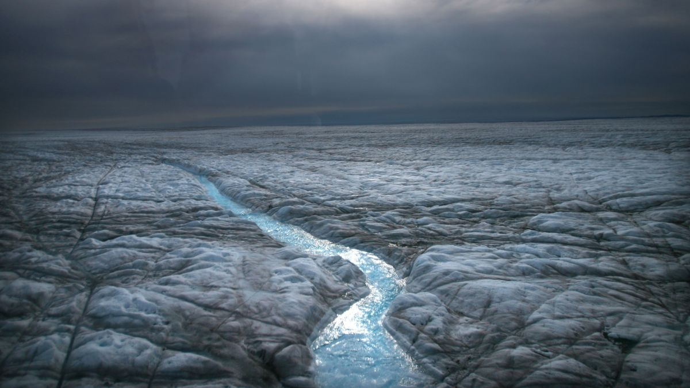

Slide 23
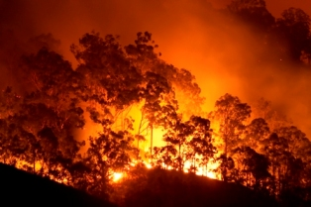
Bushfire seasons are lengthening and becoming more severe

Slide 24
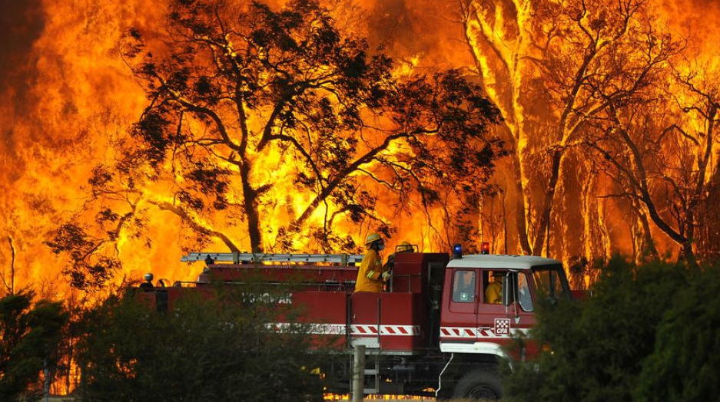
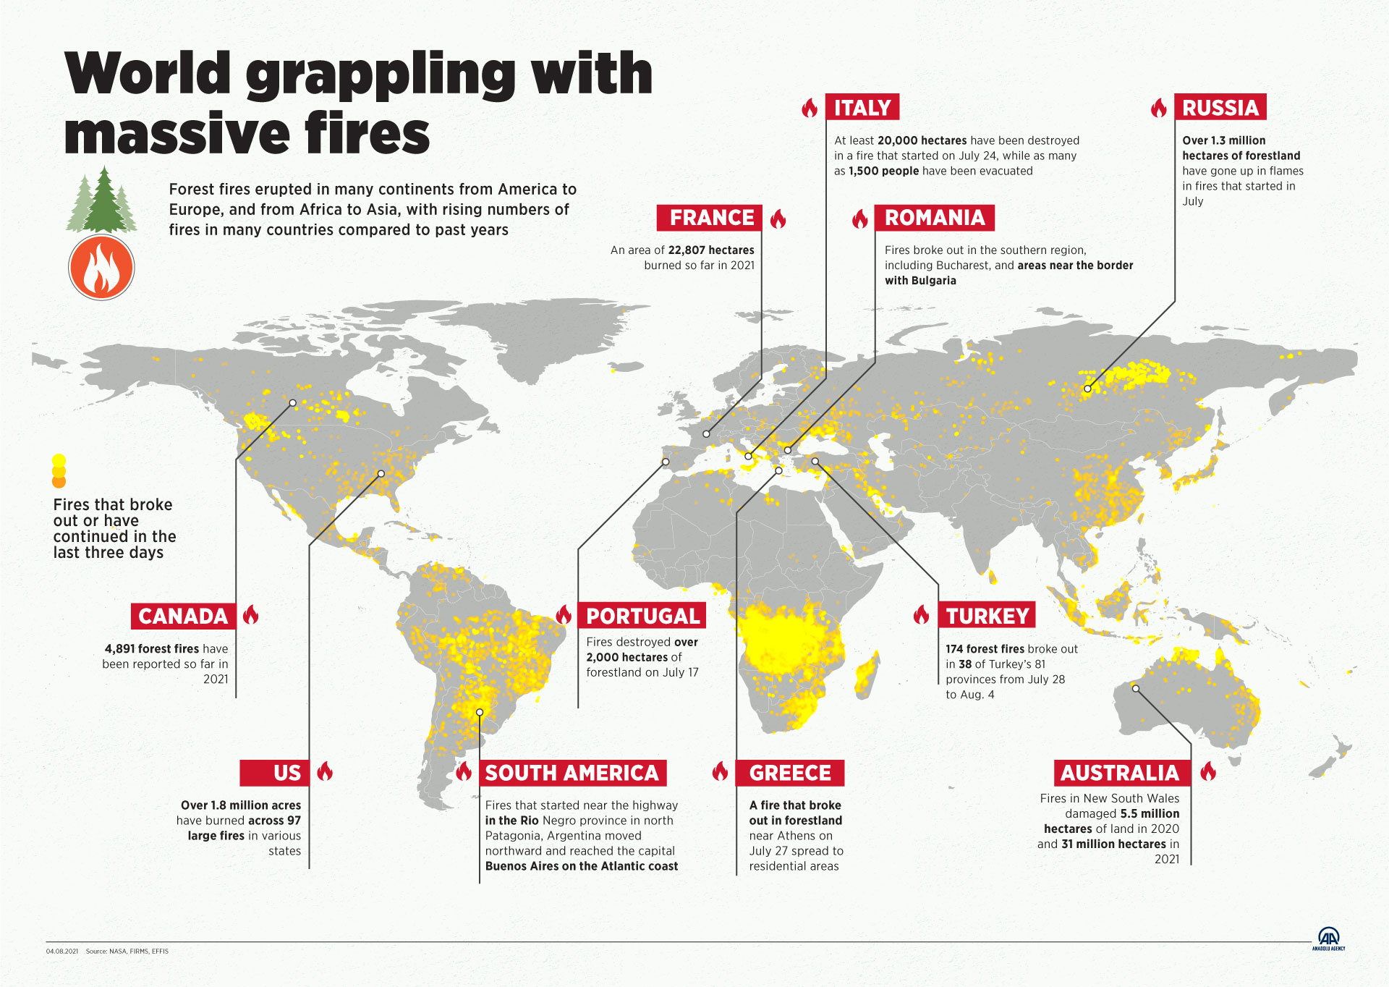
3 August 2021

Slide 25
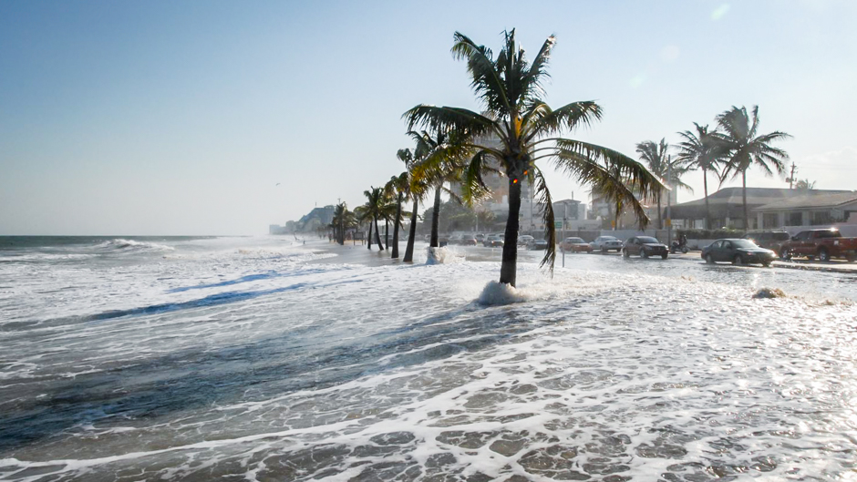
Sea level rise accelerating
Rate doubled in period 2006-2018 compared to average over previous 4 decades

Slide 26
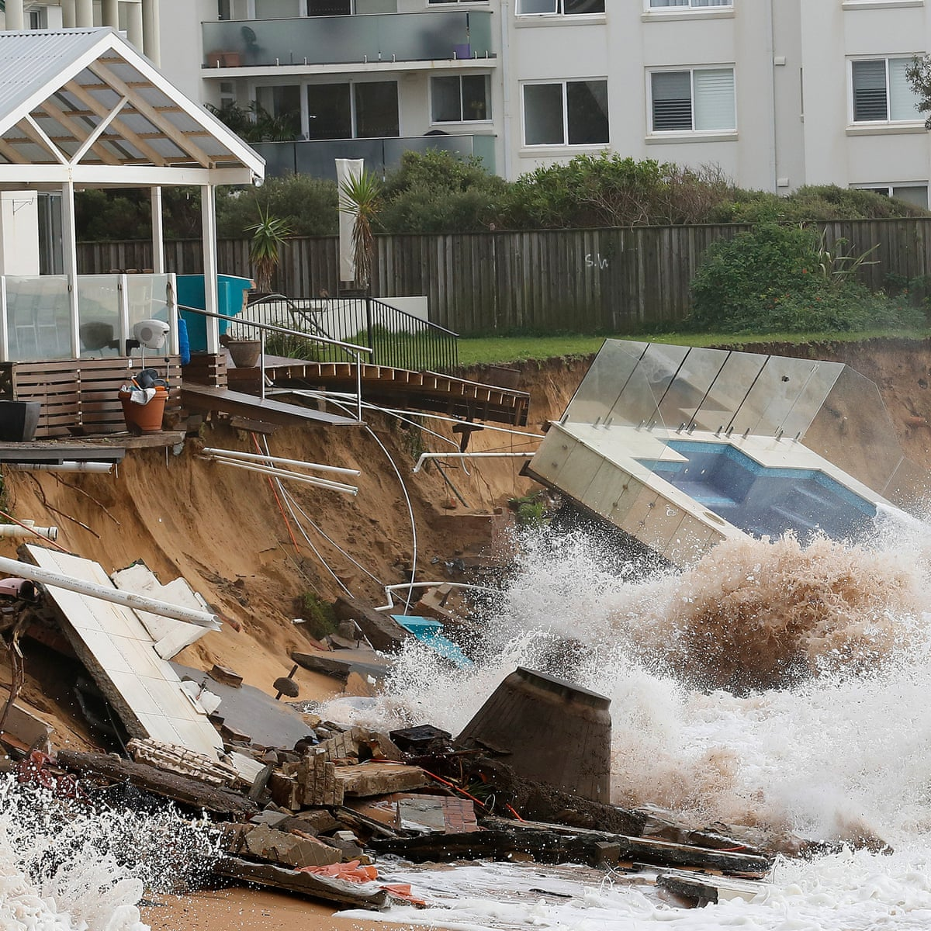
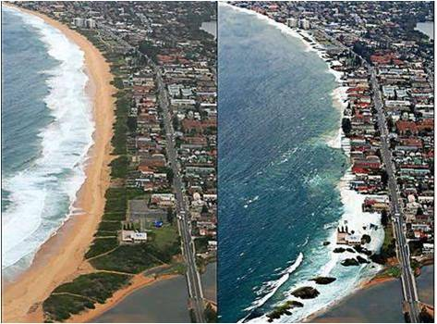
Sea levels will continue to rise over this century, up to 1.01m under high emissions scenario, and will be irreversible for hundreds or thousands of yrs
  2ºC: 2-6 m +
  5ºC: 19-22 m +
In many locations, extreme sea level events that occurred 1/100 yrs in recent past projected to occur at least annually by 2100

Slide 27
Key Findings
3. Worsening impacts are ‘baked in’ to the climate system for at least the next two decades.

Slide 28
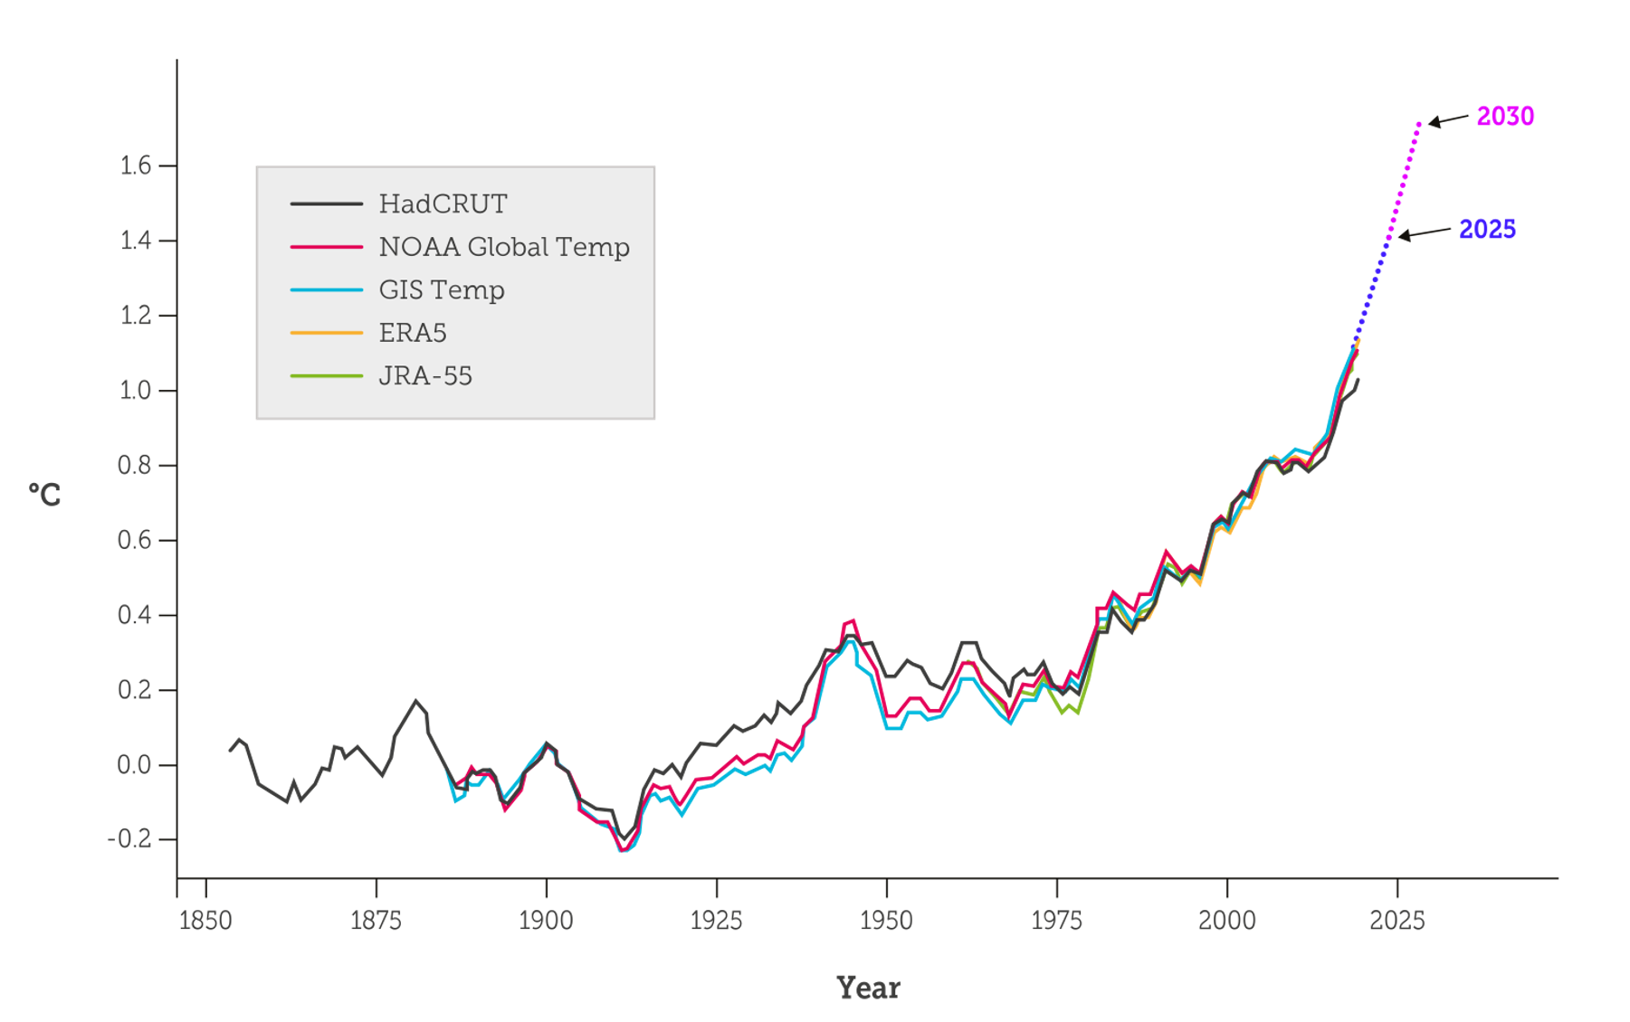
Observed and projected trajectory of the climate system
    A further 0.2 to 0.6°C is already locked in.
    We are committed to a temperature rise of 1.3 to 1.7°C, even if we could stabilise atmospheric CO₂ concentration at today’s level
    Likely to exceed 1.5ºC in the early 2030s
Climate Council 2021

Slide 29
Projected temperature rise
National
pledges
Low
Emissions
Current
policies
ES feedbacks
kick in?
High
Emissions

Slide 30
Key Findings
4. Methane is a big deal and getting bigger

Slide 31
Warming caused by methane is about 67% of that caused
by CO₂
Methane emissions have grown rapidly over last decade.
Main sources: agriculture & fossil fuels

Slide 32
Key Findings
5. Catastrophic events (tipping points) cannot be ruled out.

Slide 33
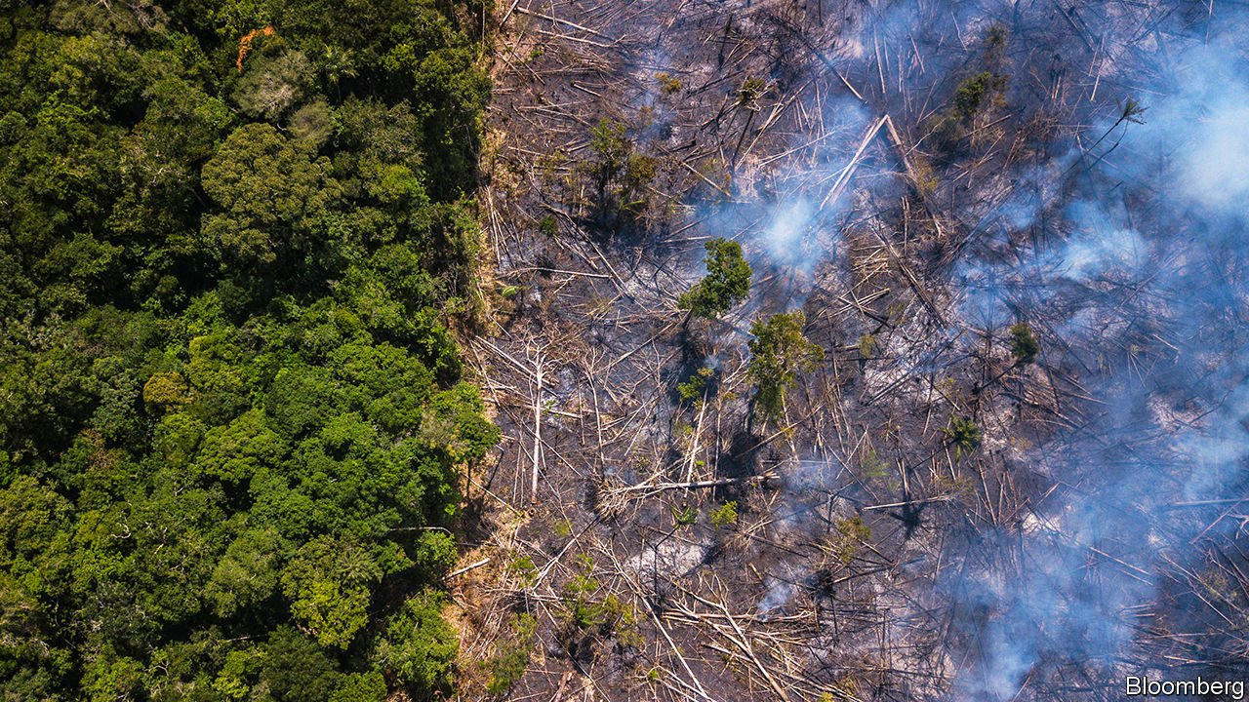
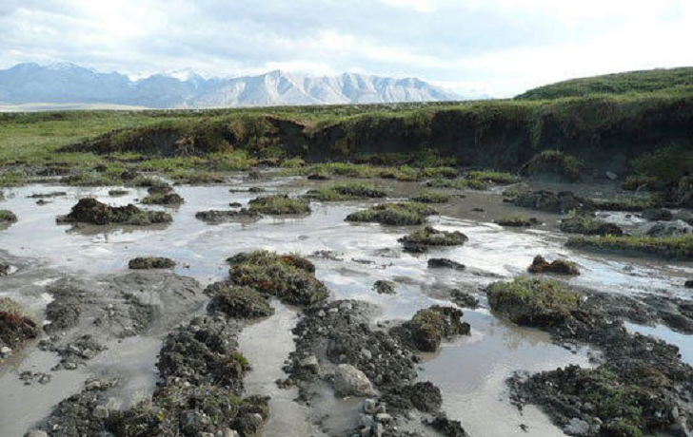
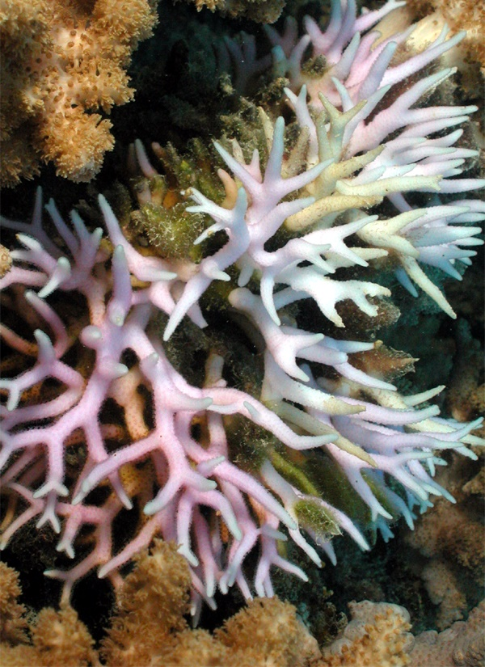
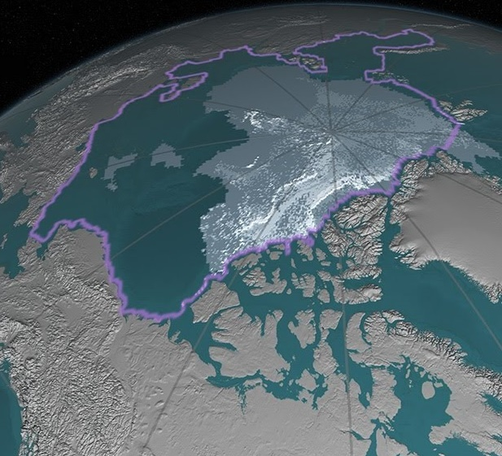
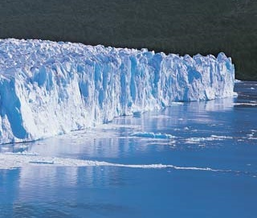
Notes:
Tipping points include conversion of Amazonian rainforest to savanna (exacerbated by clearing and burning under present government), melting of permafrost, loss of Arctic summer ice, loss of glaciers with severe impacts on the freshwater resources for about a sixth of the world’s population

Slide 34
Key Findings
6. The window for effective action is closing rapidly but the climate future is still in our hands.

Slide 35
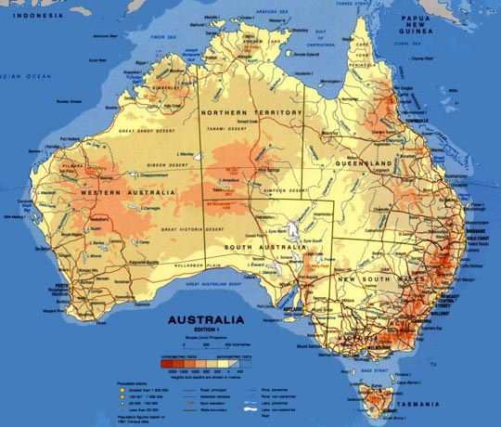

Slide 36
Some Australian stats
2019 hottest year on record
2019: 43 extremely hot days, 3x no. in any year last century
4th January 2020, Penrith hottest place on Earth, 48.9ºC

Slide 37
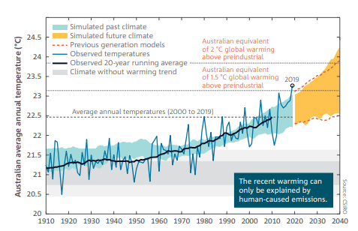
Australia heats up as emissions rise
    By end 2020, Australia had already warmed 1.44ºC since 1910
    Over the past 5 years our temperatures have been at the very upper limit of the model projections.
    Impacts felt most prominently in the extreme years, e.g. Reef bleaching.
Source: BoM and CSIRO 2020

Slide 38
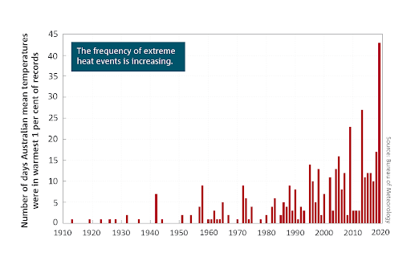
Extreme heat & heatwaves have killed more Australians than all other weather-related events combined
BoM 2020

Slide 39
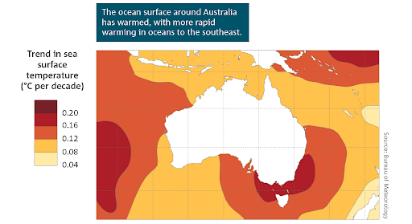

Slide 40
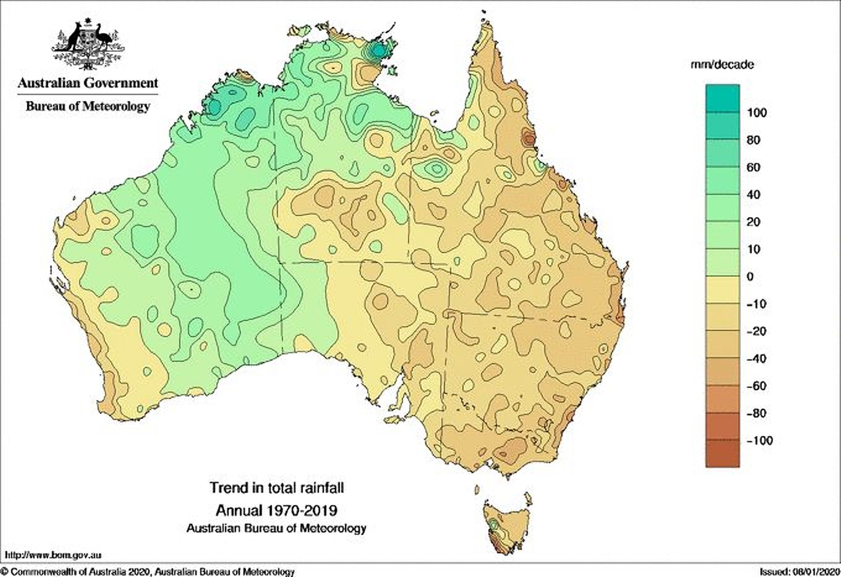

Slide 41
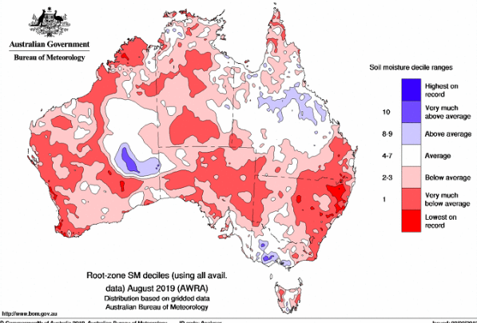
2019: Driest year on record
Rainfall 40% below average

Slide 42
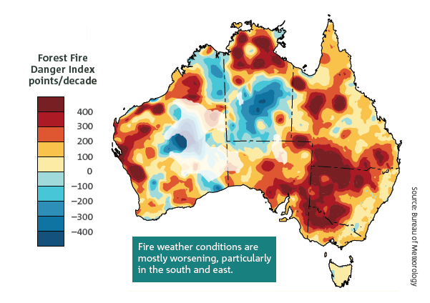
Observed trends in Forest Fire Danger Index (1978 – 2017)
CSIRO & BoM 2018
Notes:
Increasing average temperature, heatwaves and reduced rainfall is contributed to an increase in dangerous bushfire weather over most parts of Australia.
This map shows observed trends in from 1978 to 2017 in the annual (July to June) sum of the daily Forest Fire Danger Index.
Positive trends, shown in the yellow to red colours, are indicative of an increasing length and intensity of the fire weather season.
(A trend of 300 FFDI points per decade is equivalent to an average trend of 30 FFDI points per year. Areas where there are sparse data coverage such as central parts of Western Australia are faded).
Such a marked change over such a relatively short period has to be cause for deep concern

Slide 43
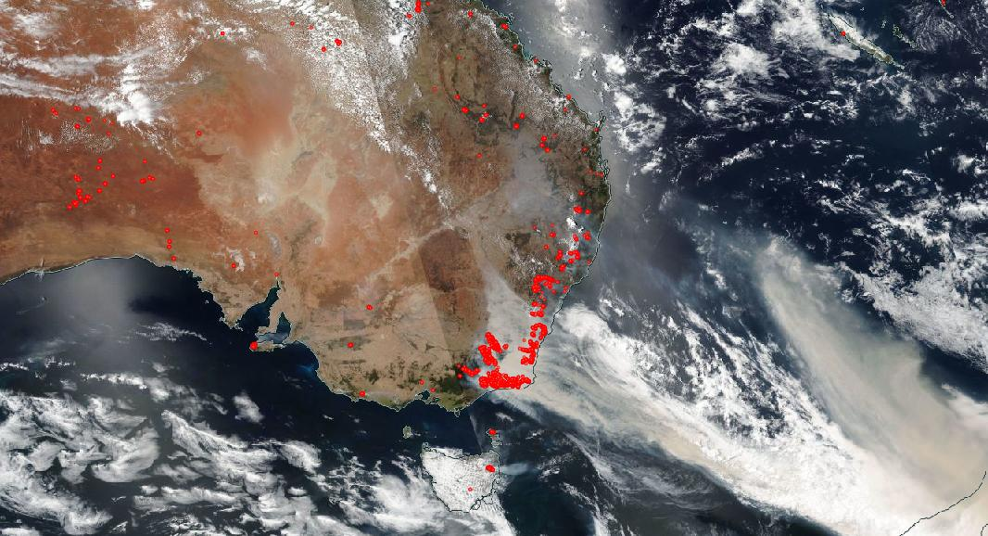
“Black Summer” bushfires 2019/20
18 million ha burnt

Slide 44
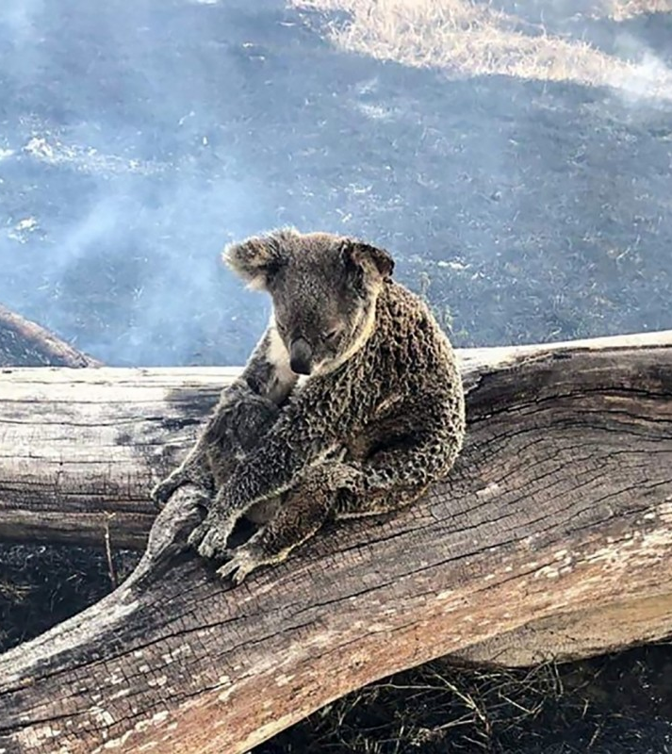
Black Summer bushfires
~3 billion native vertebrates killed (mammals, birds & reptiles)
Many threatened species lost most or all their habitat
80% Blue Mountains WHA burnt
50% Gondwanan rainforests burnt

Slide 45
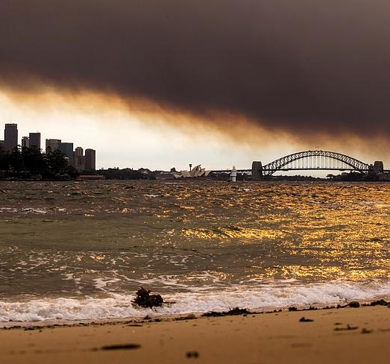
Impacts
>3000 homes lost
Overall costs approaching $100 billion, costliest climate-related disaster in Australia’s history
>400 excess deaths; >4000 increased hospital admissions; 8 million affected by smoke
https://theconversation.com/with-costs-approaching-100-billion-the-fires-are-australias-costliest-natural-disaster-129433

Slide 46
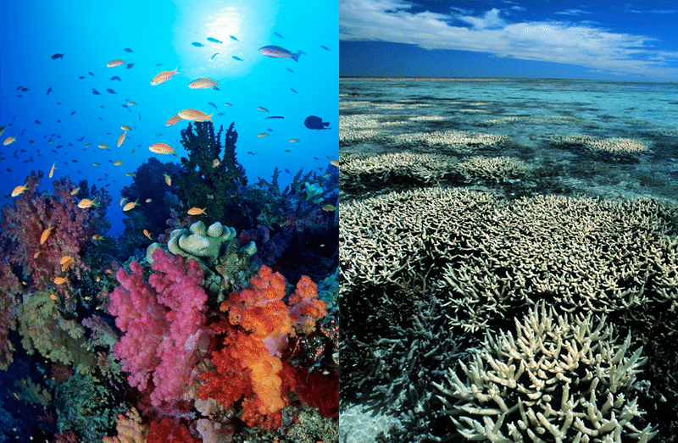
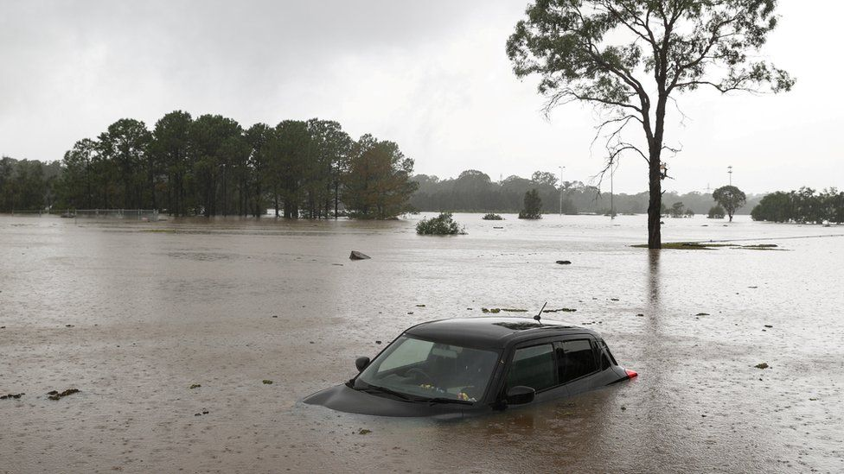
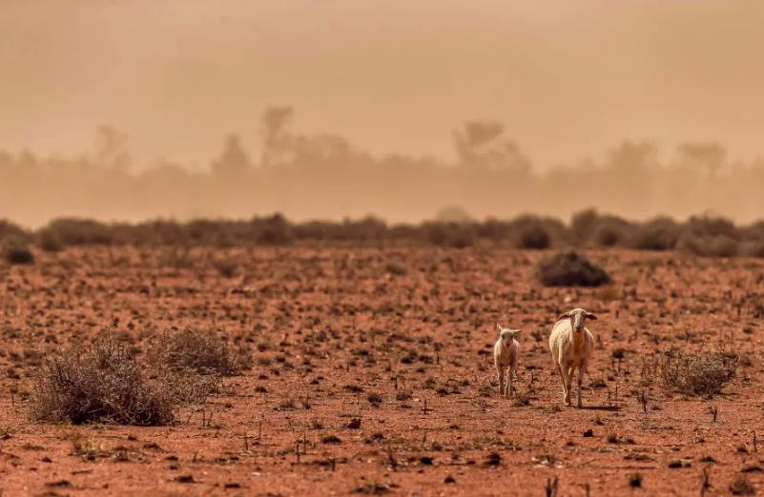
Marine heatwaves & ocean acidity increasing
Heatwaves & fire risk increasing
Rainfall patterns related to ENSO amplified by the second half of the century
Sea levels rising faster than global average
More regions affected by drought in south, east & southwest, increase in sand and dust storms

Slide 47
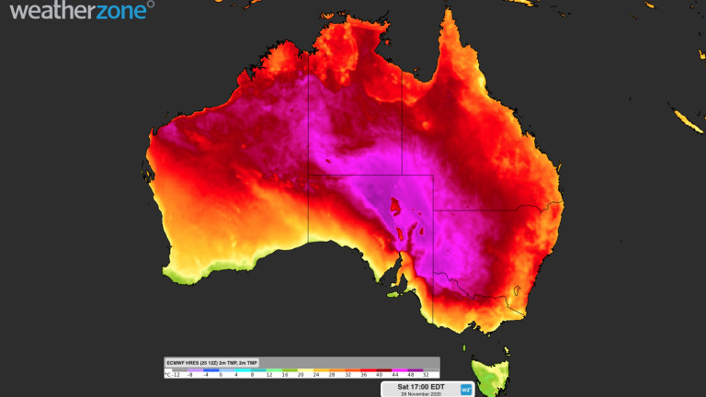
Average no. days >35ºC in Western Sydney could increase 5 x by 2090
50ºC days in Australian capital cities could be relatively common by mid-century
Purtil 2021
Lewis et al. 2017

Slide 48
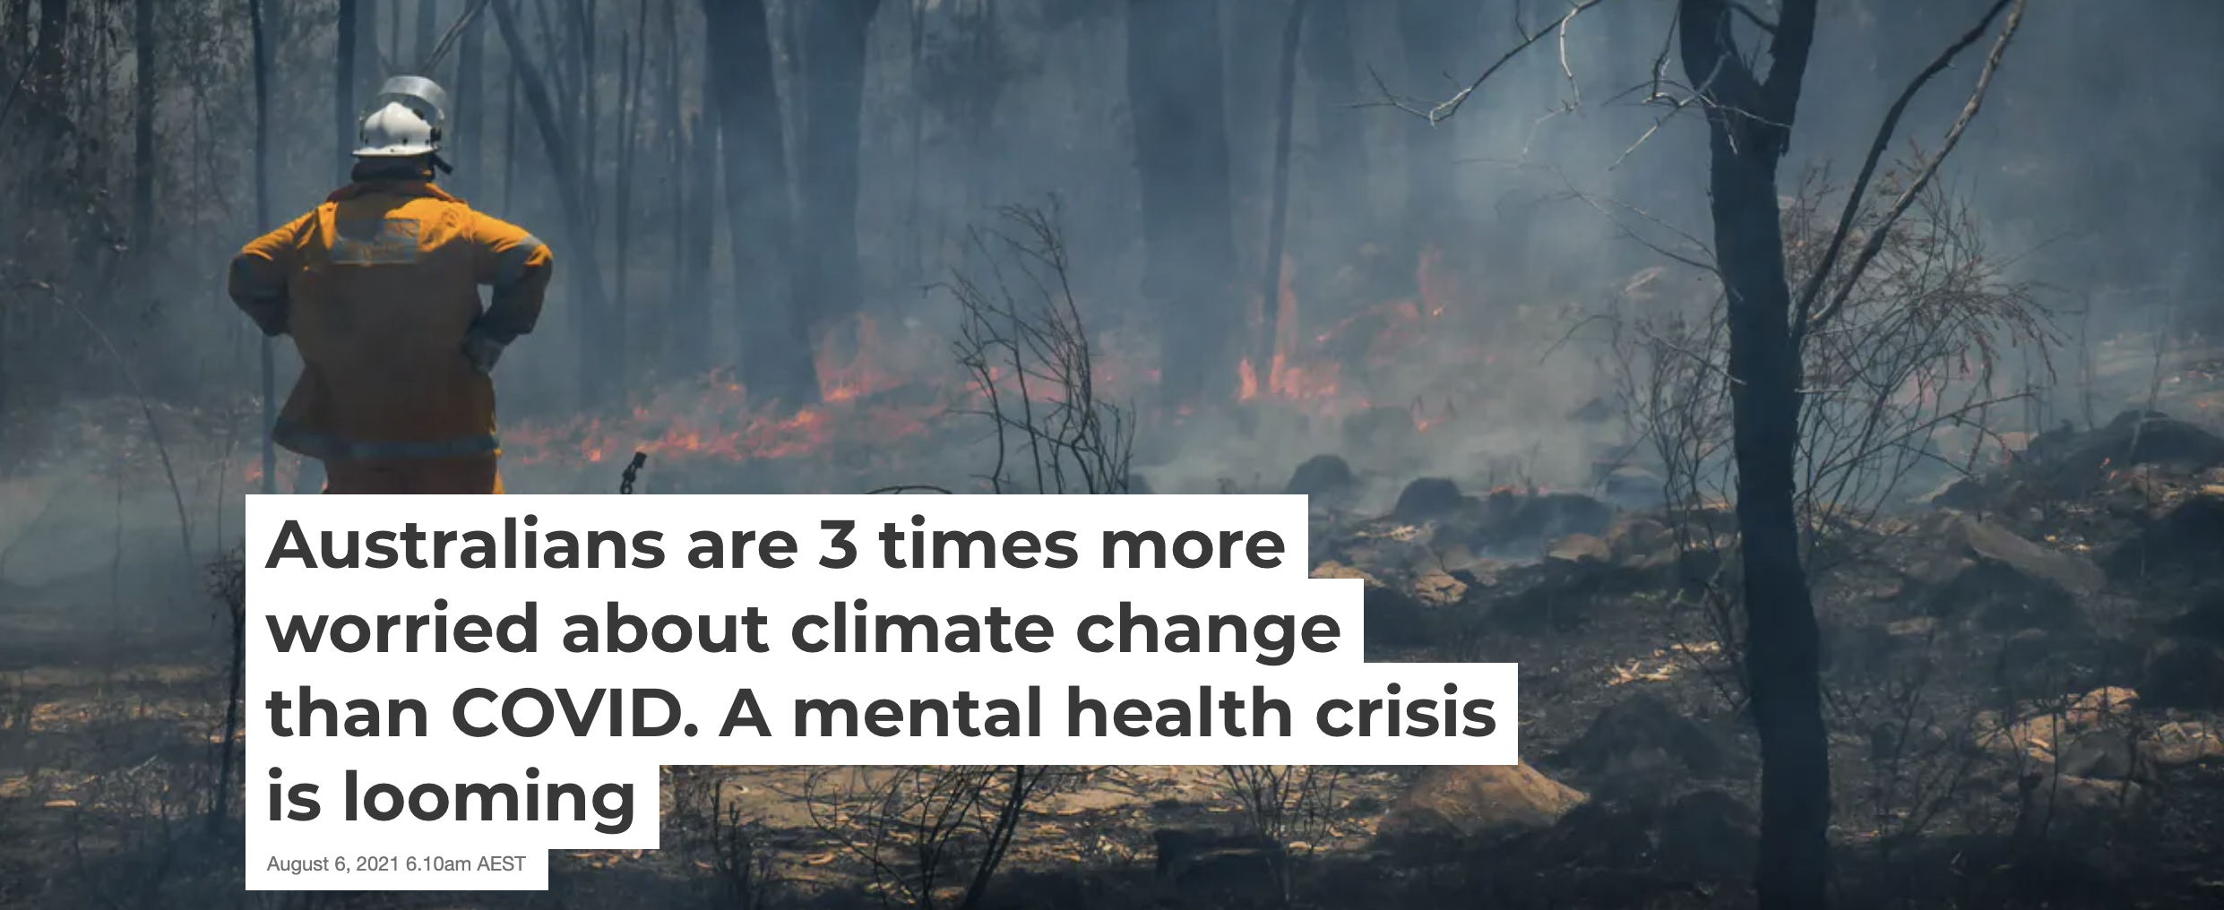
https://theconversation.com/australians-are-3-times-more-worried-about-climate-change-than-covid-a-mental-health-crisis-is-looming-165470
Patrick et al. 2021
https://www.sciencedirect.com/science/article/pii/S2667278221000298?via%3Dihub

Slide 49
Outline
What is the IPCC & why is the AR6 so important?
Key messages
What we need to do

Slide 50
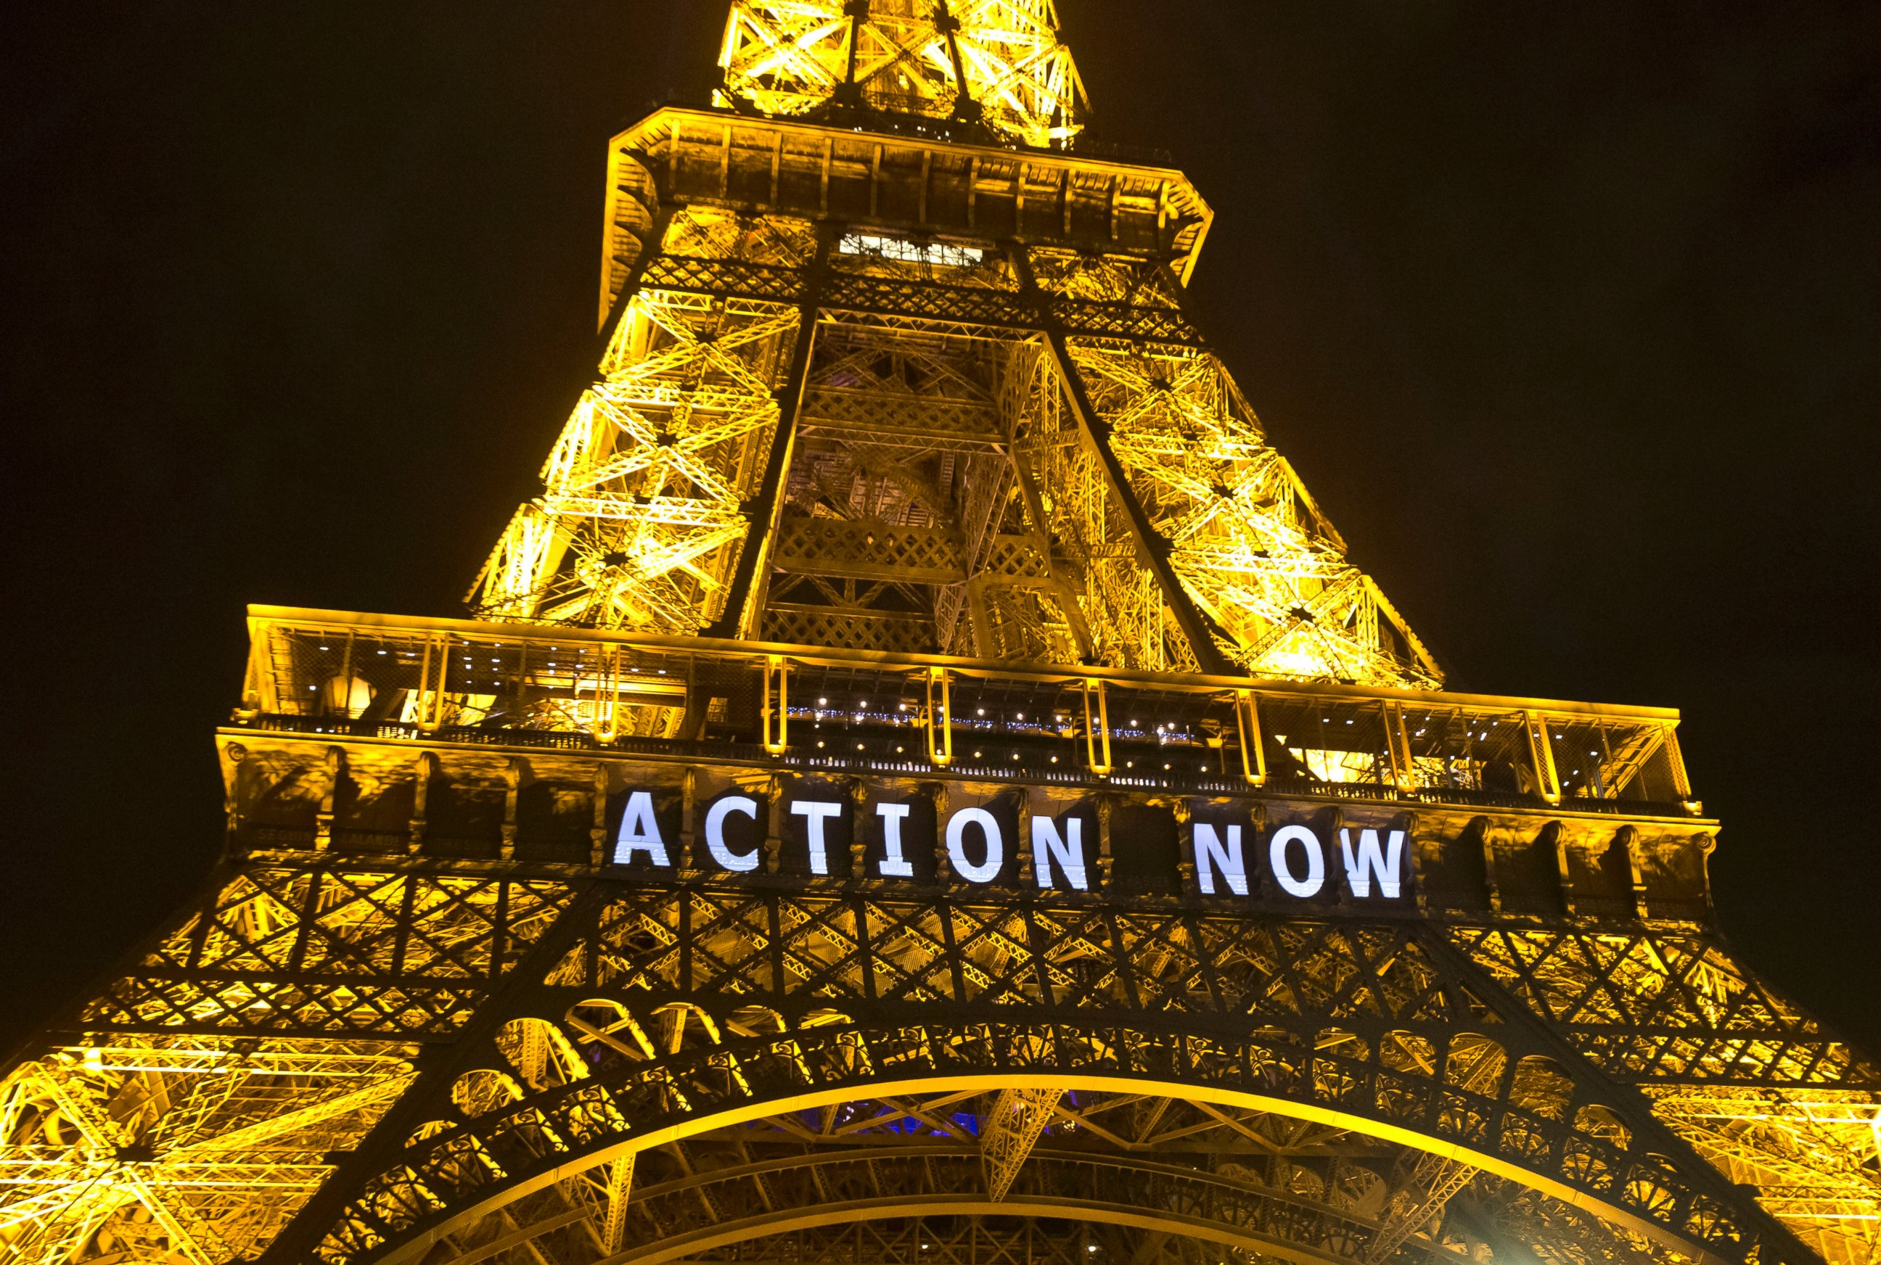
Aim: <2ºC
Aspiration: <1.5ºC
Pledges thus far will lead to 3ºC warming

Slide 51
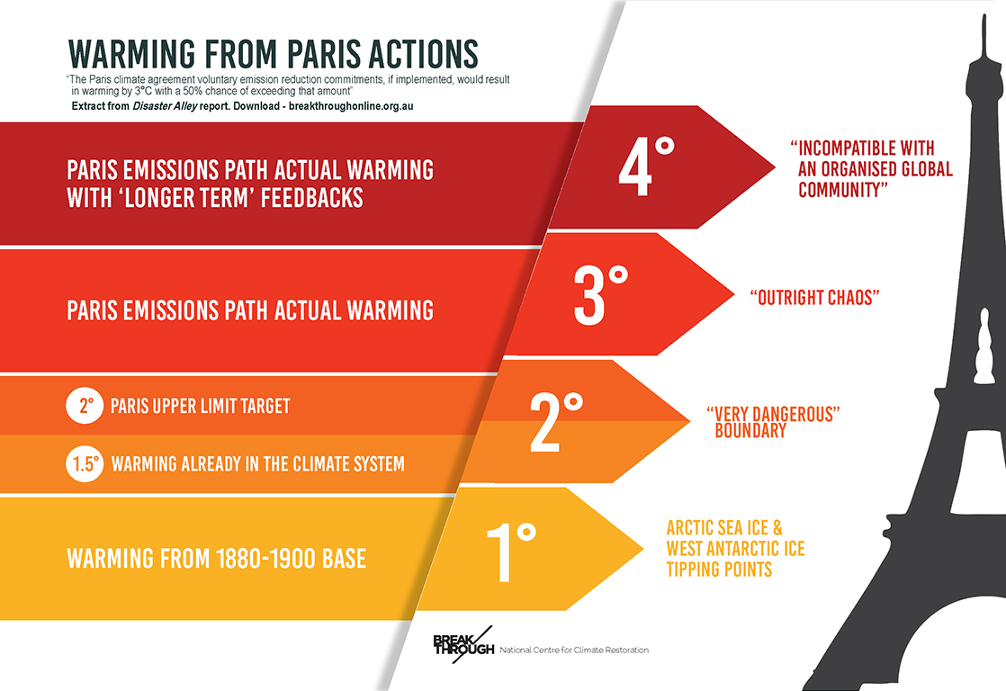

Slide 52
“…effects of substantial reductions in CO₂ emissions would not be apparent immediately, and the time required to detect the effects would depend on the scale and pace of emissions reductions.
Under the 4 lower-emission scenarios…..the slowing down of global surface warming would be detectable after ~20-30 years.”
Notes:
Leaked report indicates many tipping points are closer than previously thought

Slide 53
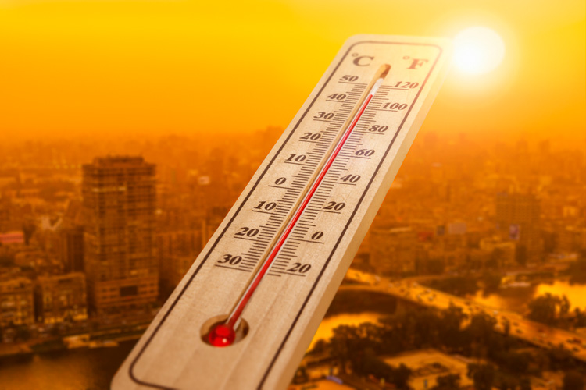
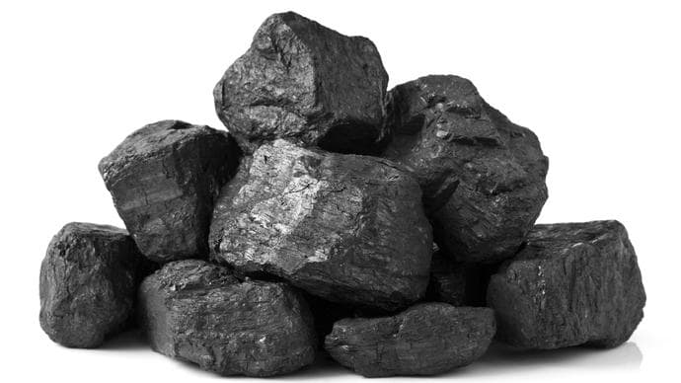
The Carbon Budget
Giga tonnes
ºC

Slide 54

1.5ºC
Will we meet the 1.5ºC target?
Current emission rates 11.5 Gt C p.a
At this rate, the carbon budget will be fully spent in 2.5 years from now
Meeting this target would need 5-fold increase in global Paris pledges, and their successful implementation

Slide 55
1.5ºC
Will we meet the 2ºC target?
Current emission rates 11.5 Gt C p.a
At this rate, the carbon budget will be fully spent in 9.5 years from now
Meeting this target would need 3-fold increase in global Paris pledges, and their successful implementation

Slide 56
1.5ºC
To stay below 2ºC
Emissions must be at least halved by 2030

Slide 57
1.5ºC
To stay below 2ºC
Emissions must be at least halved by 2030
….and we must be at net zero by 2040 at the latest
2050 is too late

Slide 58



Slide 59
Australia ranked last on climate policy & action
Down from last year (2nd last)

Slide 60

https://www.climatecouncil.org.au/resources/net-zero-emissions-plummet-decade/

Slide 61

Australia’s fair share
Calculation of national target based on:
Current and past emissions
Level of economic development
Ease of reduction compared to other countries
Feasibility / pathway of reaching such a goal

Slide 62
Australia’s fair share
Aim to:
reduce emissions 75% below 2005 levels by 2030
reach net zero by 2035

Slide 63
Australia’s fair share
Requires an immense, all-of-society effort
ClimateWorks has modelled a pathway for Australia to net zero by 2035 and considered every sector of our economy
Major opportunity for Australia, with some of the best renewable resources in the world, skilled workforce and easy trade access to Asia

Slide 64

Signatories to Agreement expected to increase level of ambition
Australia has indicated no change to target

Slide 65





55%
40-45%
68%
“The benefits of stronger action will be realized within our lifetimes” (next 20-30 years) (IPCC 2021)
50%
46%

Slide 66
We are in a climate emergency
Our physical & biological world is transforming
We don’t have much time

Slide 67
Every fraction of a degree matters
Every year matters
Every choice matters

Slide 68


