Slide 1
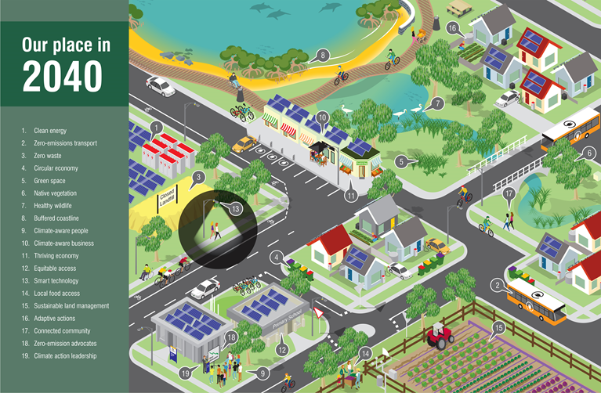
Mornington Peninsula Shire Getting to net zero: The relationship between targets and action

Slide 2
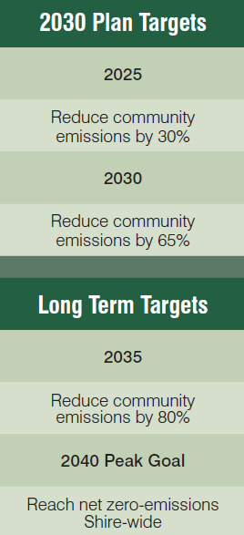
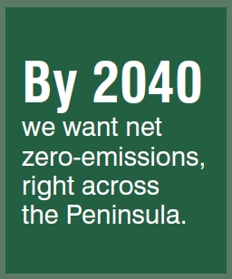
Mornington Peninsula Shire’s emissions reductions targets

Slide 3
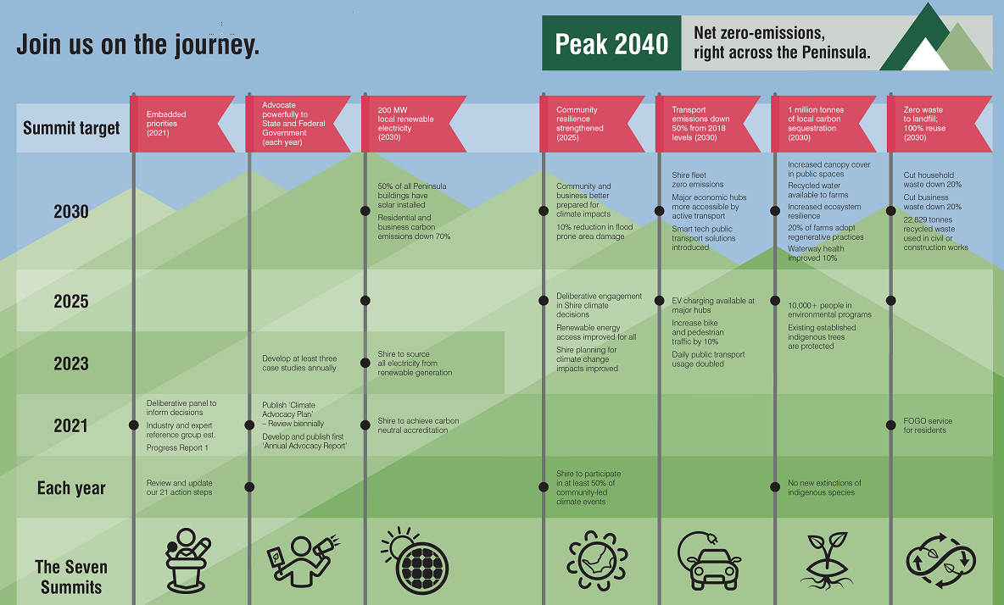

Slide 4
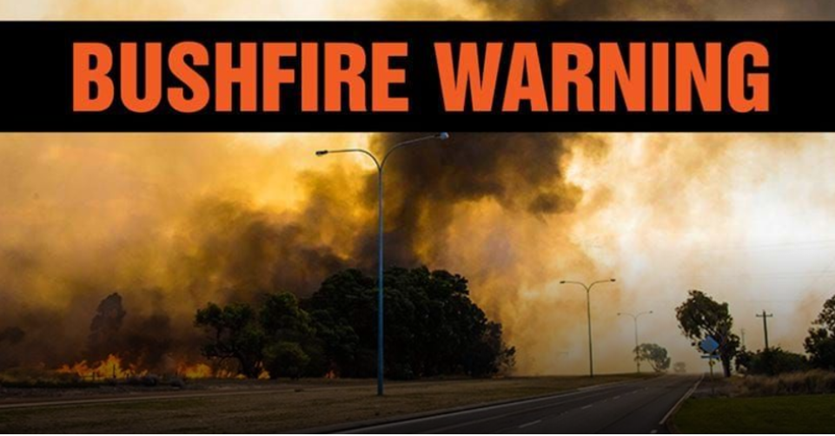
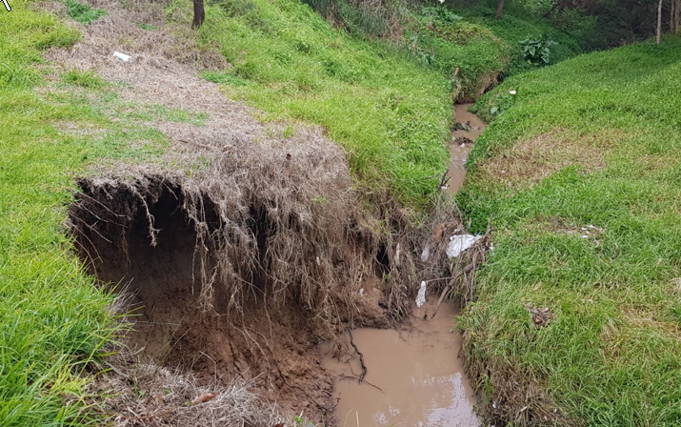
Why by 2040?
The earth’s current emission levels, as assessed and reported by the Intergovernmental Panel on Climate Change (IPCC), put us on a dangerous path towards three to four degrees of increase.
We need to act urgently. We need to do more to meet our Paris Agreement targets sooner.

Slide 5
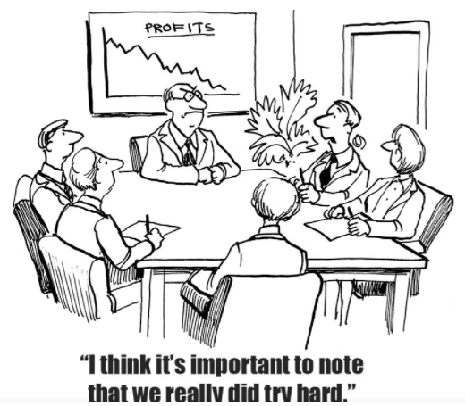
Targets are critical

Slide 6
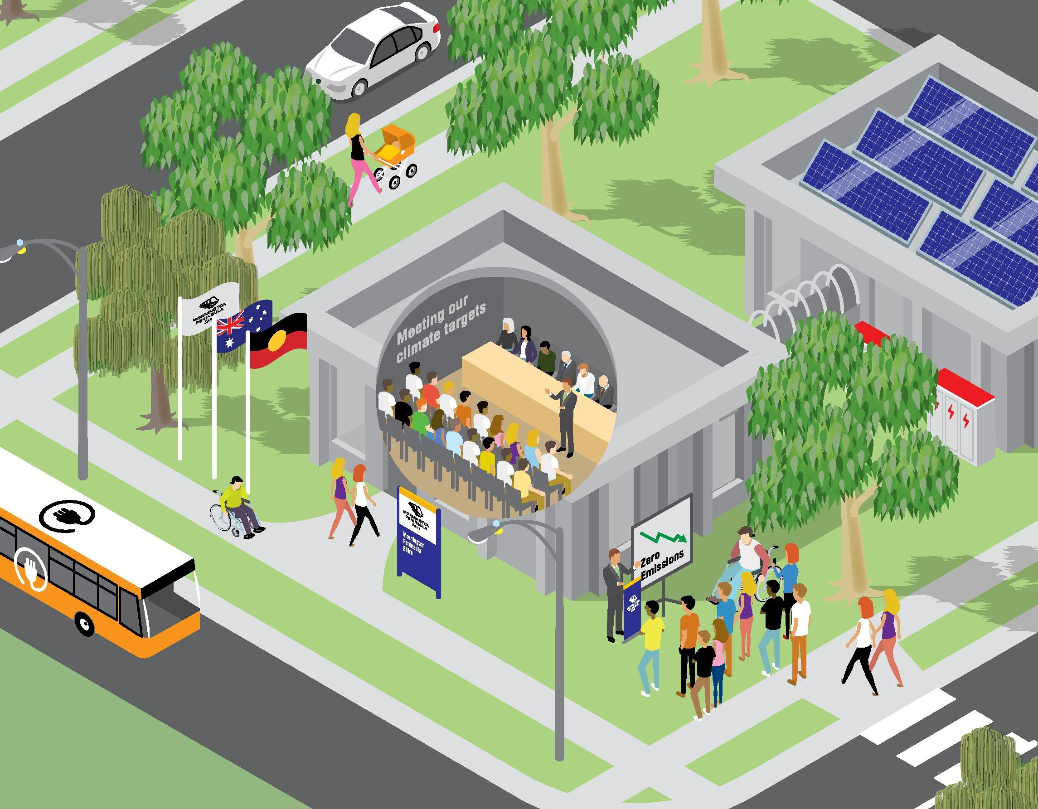
Working with Council
"Mornington Peninsula Shire is ready to lead by example and show the way. We’ll take action, enable and inspire others, and courageously call out what’s missing in action. We can no longer wait to ensure our future. Join us on this journey. Because we cannot make it without you,” concluded Mayor Hearn.
(Mayor in 2020).

Slide 7
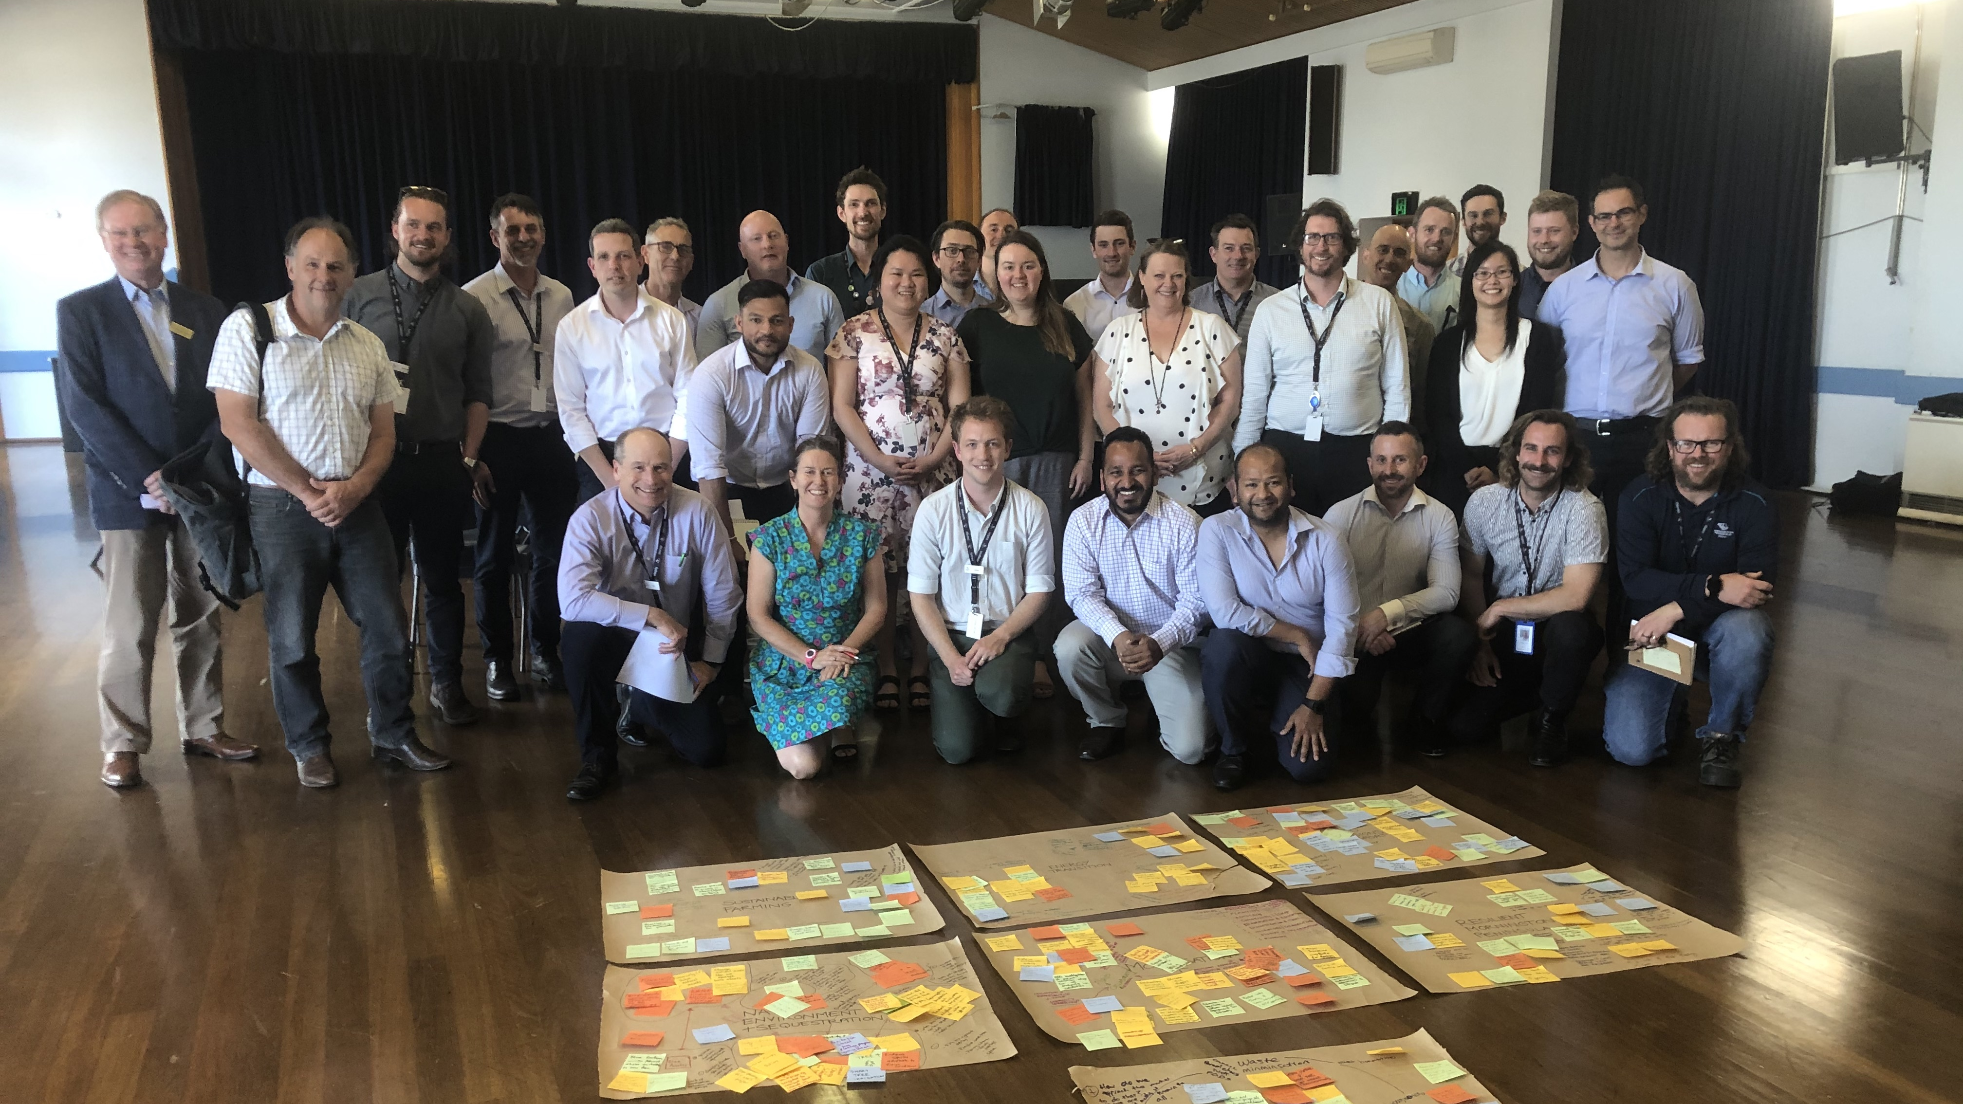
Staff engagement

Slide 8
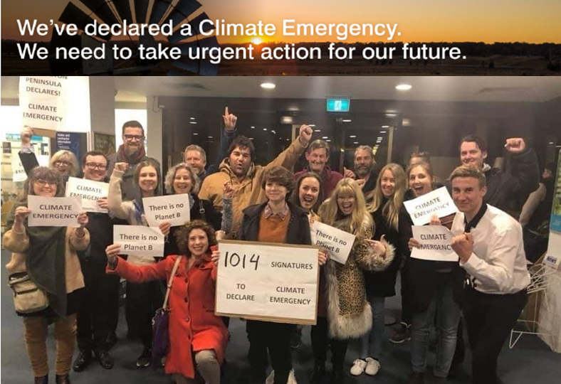
Community engagement

Slide 9
Community engagement

Slide 10
QUESTIONS and THANK YOU
Where to get more info:
Climate Emergency newsletter (Climate Change news and updates (mailchi.mp)
Climate Emergency website (https://www.mornpen.vic.gov.au/Your-Property/Environment/Climate-Change)

